Slide 1
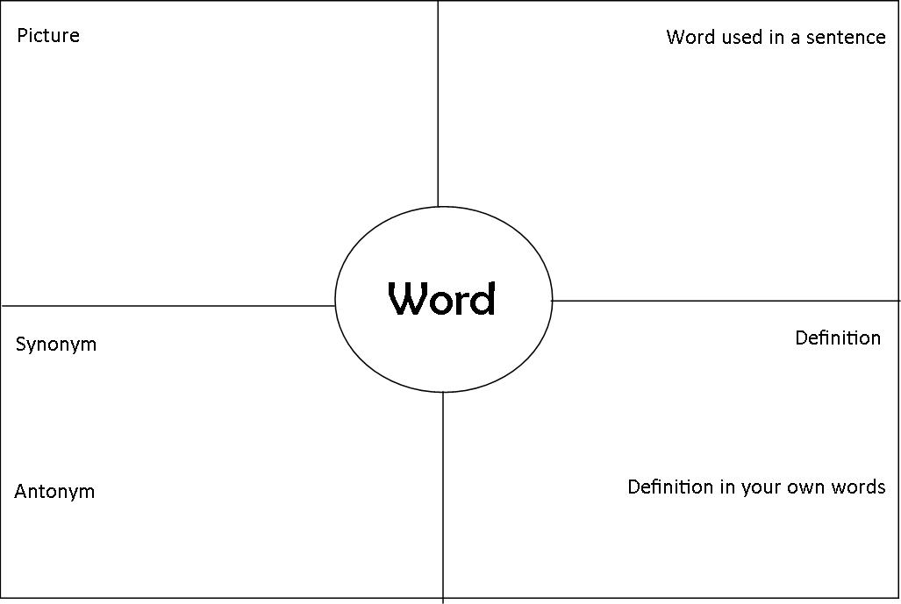
Focus: Draw 10 4-square boxes (I would try to draw 10 per page (so only 2 pages total)

Slide 2
Unit 1 vocabulary

Slide 3
admonish
Verb
To caution or advise against something; to scold; to remind of a duty

Slide 4
breach
Noun
An opening, gap, rupture, rift; a violation or infraction
Verb
To create an opening, break through

Slide 5
brigand
Noun
A bandit, robber, outlaw, highwayman

Slide 6
circumspect
Adjective
Careful, cautious

Slide 7
Commandeer
VERB
TO SEIZE FOR MILITARY OR OFFICIAL USE

Slide 8
CUMBERSOME
ADJECTIVE
CLUMSY, HARD TO HANDLE; SLOW-MOVING

Slide 9
DEADLOCK
NOUN
A STANDSTILL RESULTING FROM THE OPPOSITION OF TWO EQUAL FORCES OR FRACTIONS
VERB
TO BRING TO SUCH A STANDSTILL

Slide 10
DEBRIS
NOUN
SCATTERED FRAGMENTS, WRECKAGE

Slide 11
DIFFUSE
VERB
TO SPREAD OR SCATTER FREELY OR WIDELY
ADJECTIVE
WORDY, LONG-WINDED, OR UNFOCUSED; SCATTERED OR WIDELY SPREAD

Slide 12
DILEMMA
NOUN
A DIFFICULT OR PERPLEXING SITUATION OR PROBLEM

