Slide 1
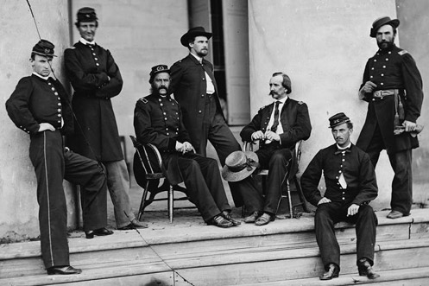
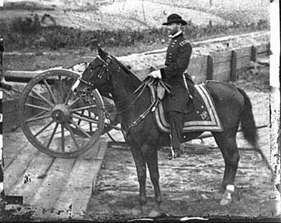
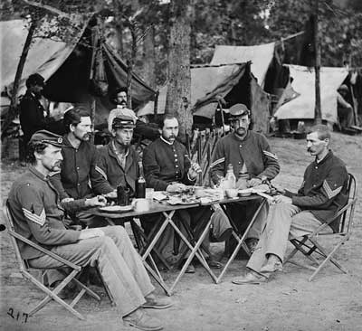
The Civil War
1861-1865

Slide 2
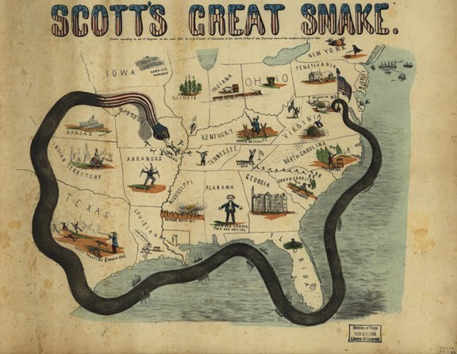
Anaconda Plan (Union)
USA wanted to blockade CSA ports
USA wanted to take control of the Mississippi River (split the South in half)

Slide 3
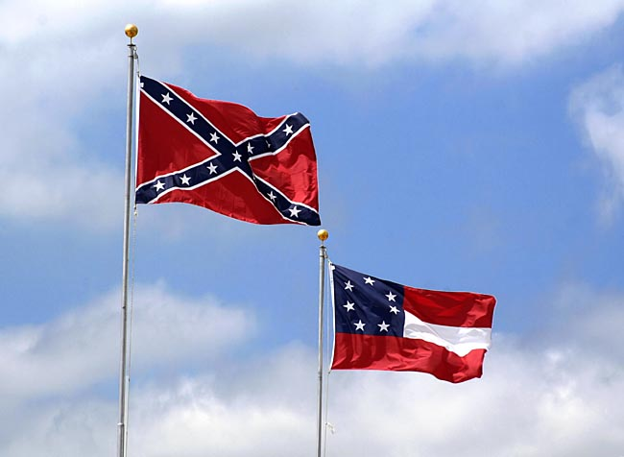
Confederate Plan
War of attrition
Get help from Europe

Slide 4
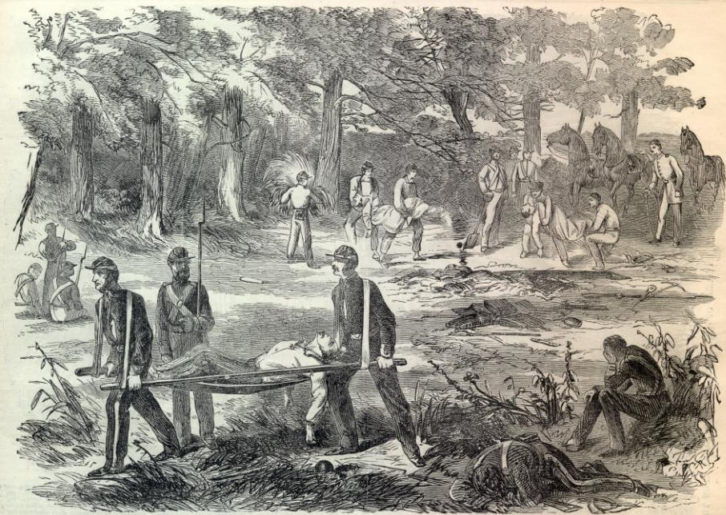
July 1861 – Battle of Bull Run
Virginia
First official battle of the Civil War
Confederate victory

Slide 5
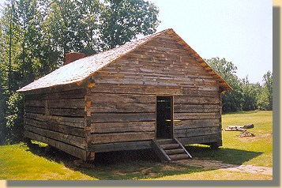
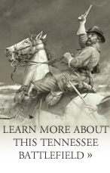
April 1862 – Battle of Shiloh
Tennessee
Small white church
Union Victory

Slide 6
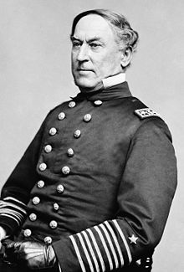
May 1862 – Battle of New Orleans
Louisiana
Union gains control of the port of New Orleans led by Admiral Farragut
Prevents trade (imports & exports)
Union Victory

Slide 7
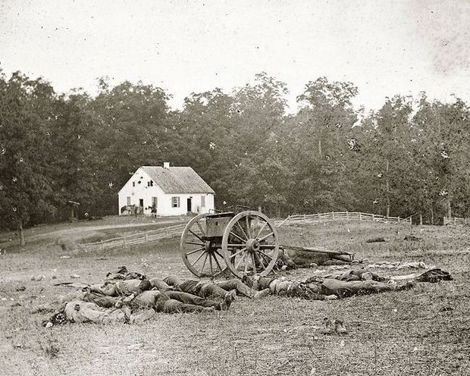
September 1862 – Battle of Antietam
Maryland
Bloodiest single day and battle of the Civil War
DRAW

Slide 8
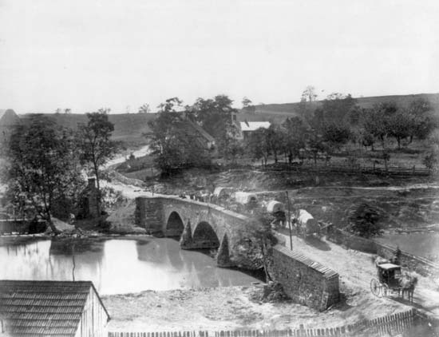

Slide 9
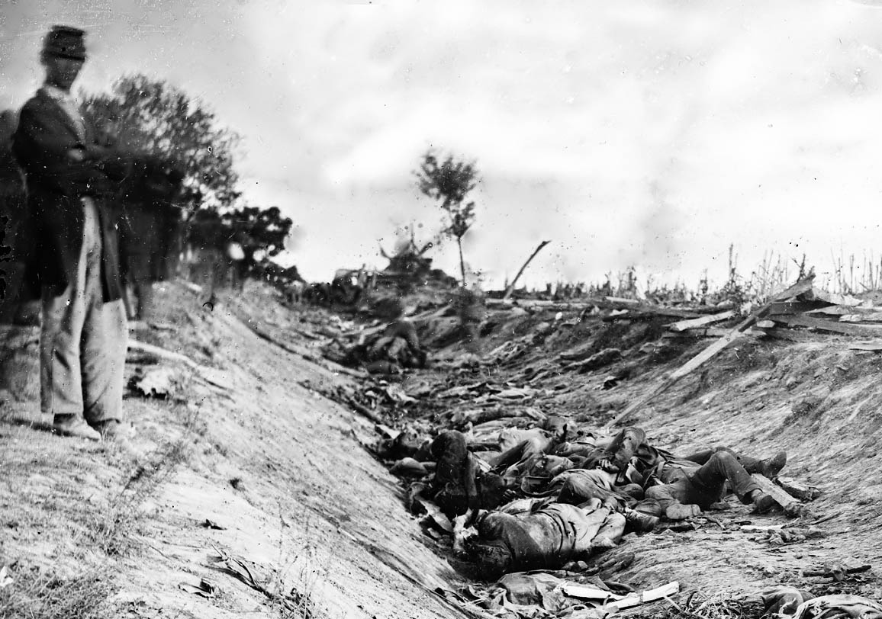

Slide 10
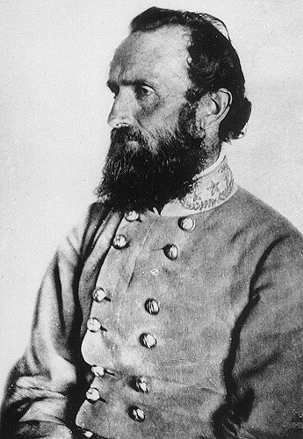
May 1863 - Battle of Chancellorsville
Virginia
Lee gains confidence in his army, decides to invade the Union
General Stonewall Jackson (CSA) dies
Confederate Victory

Slide 11
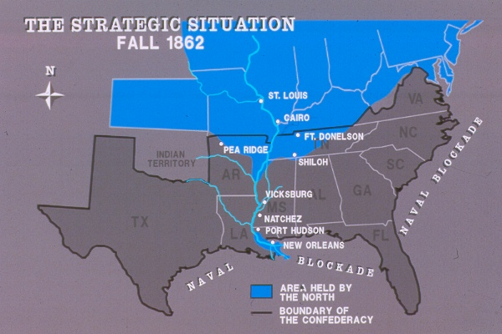
May-July 1863 – The Battle of Vicksburg
Mississippi
Union gains full control of the MS River
Union troops led by General Ulysses Grant
Union Victory

Slide 12
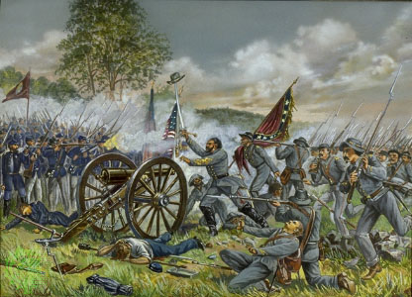
July 1863 – The Battle of Gettysburg
Pennsylvania
TURNING POINT of the Civil War
Confederate troops are decimated – army will never recover from losses
Union Victory

Slide 13
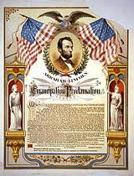
Emancipation Proclamation
Issued by Lincoln on Jan. 1, 1863
Proclaimed that all slaves in states still at war with the Union were to be freed
Did not mention slaves in the border states (to prevent defection)
Lincoln technically had no jurisdiction over the CSA

Slide 14
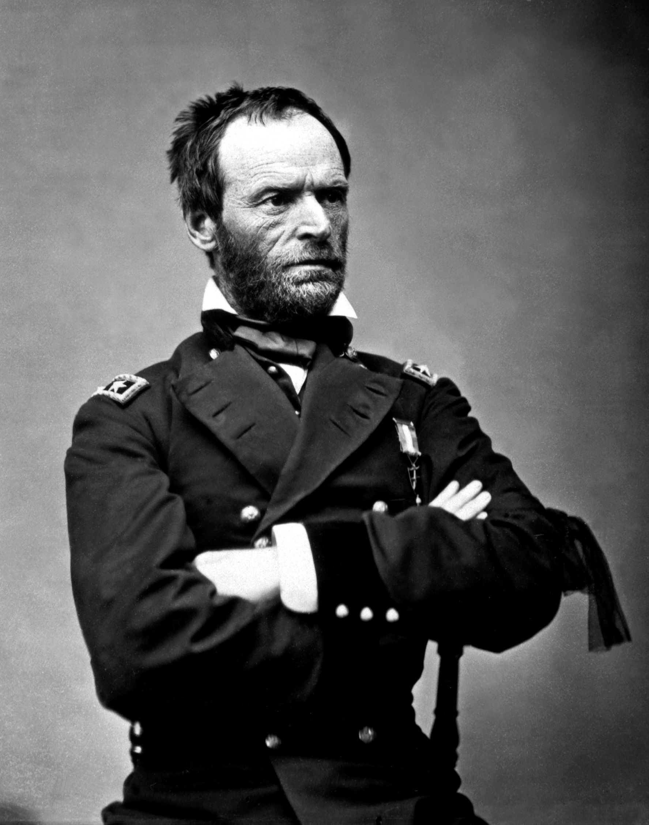
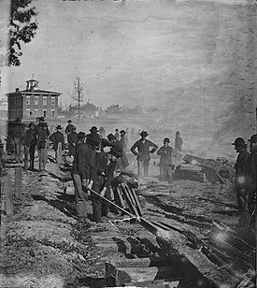
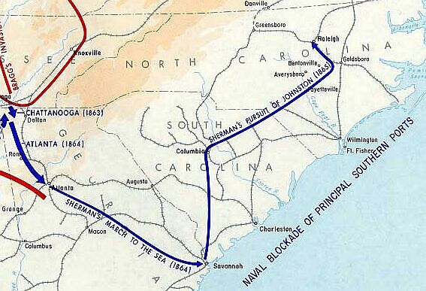
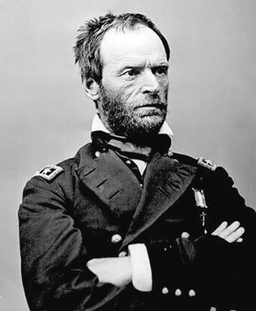
Sherman’s March to the Sea
Union invasion of the Confederacy
TN, GA, SC, NC, VA
TOTAL WAR – utilizing all resources to wage war on civilians, burn & destroy Confederate resources

Slide 15
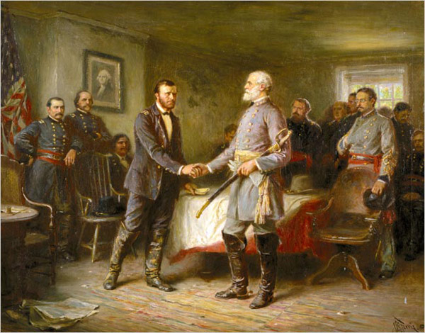
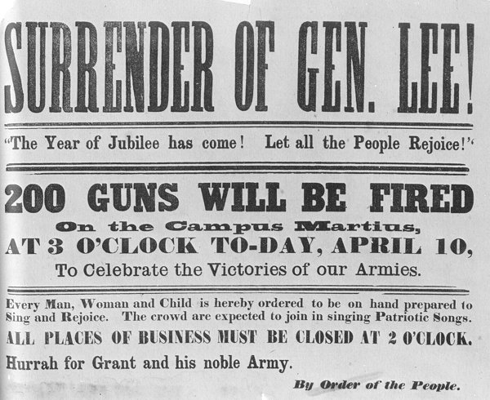
Surrender at Appomattox
April 9, 1865
Lee surrenders to Grant at courthouse
Union officially wins the war

Slide 16
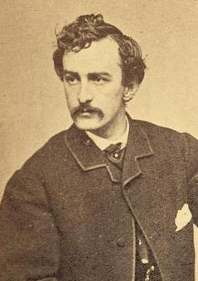
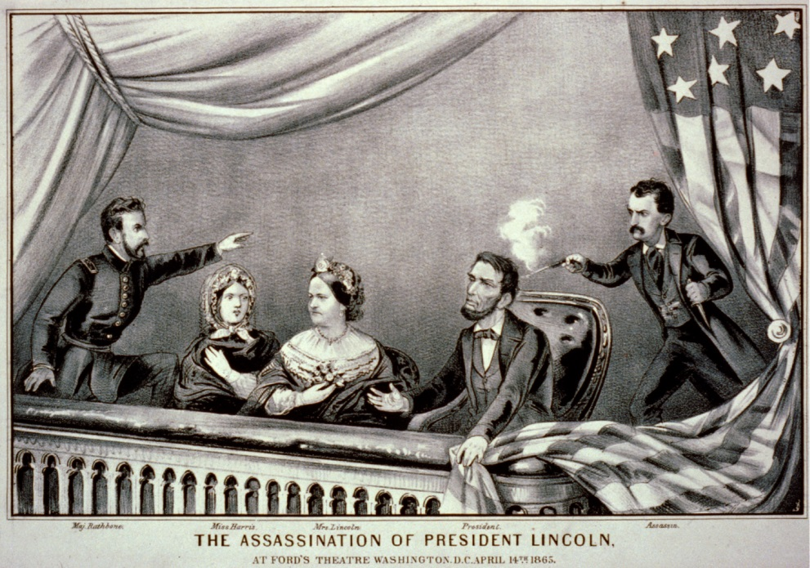
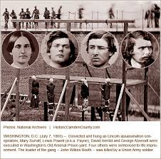
Assassination of Lincoln
April 15, 1865
Ford’s Theatre – Washington, DC
John Wilkes Booth

