Slide 1
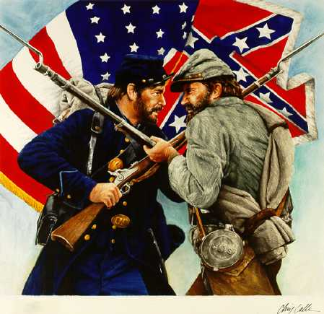
Pre-Civil War timeline
1850-1861

Slide 2
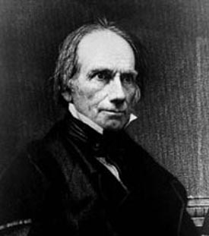
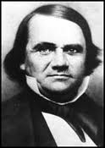
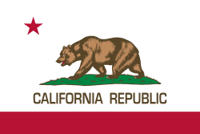
1850
Compromise of 1850
1) California admitted as free state
2) Territories from Mexican Cession would use popular sovereignty (people decide) on slavery
3) TX received $10M
4) Slave trade abolished in D.C.
5) Fugitive Slave Act – caused failure of the compromise
Henry Clay & Stephen Douglas write the compromise

Slide 3
Compromise of 1850

Slide 4
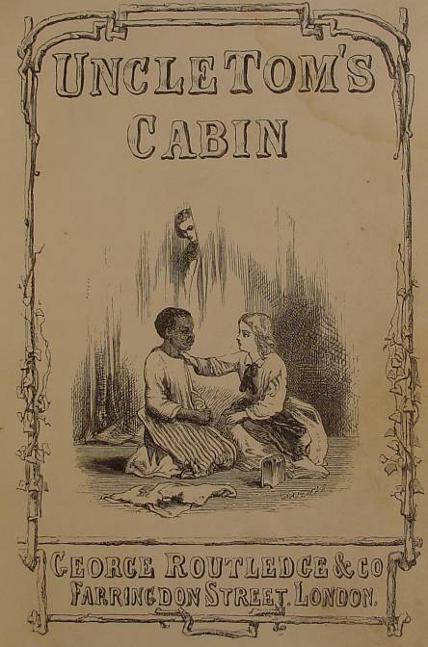
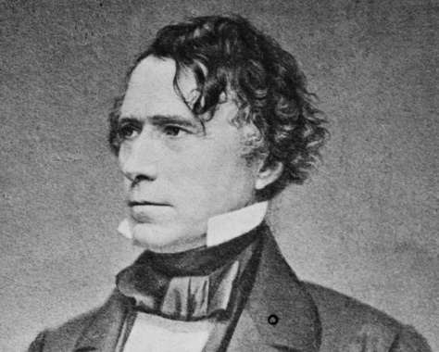
1852
Election of 1852
Franklin Pierce (D) elected president
Does not help to solve sectionalism issues
Uncle Tom’s Cabin by Harriet Beecher Stowe – book portrays slaves as individuals; raises awareness & causes tension between North/South

Slide 5
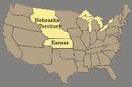
1854
Kansas-Nebraska Act
Repealed the Missouri Compromise
Divided the territory into 2 states (KS, NE)
Use of popular sovereignty to decide if the state would be slave or free (people decide)
-- Stephen Douglas writes most of the act --

Slide 6
1854

Slide 7
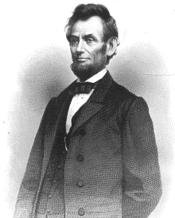
1854
Bleeding Kansas
Mini-Civil War (violence over voting)
Republican Party forms
Against slavery
Didn’t want it to spread to the territories

Slide 8
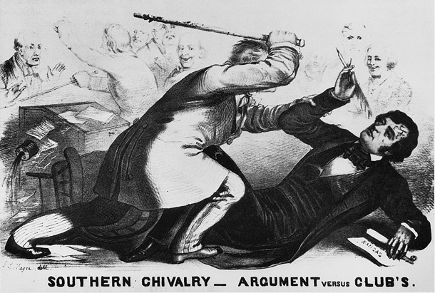
1856
Brooks-Sumner Caning
Sumner insults Brooks’ relative & the South
Results in Brooks beating Sumner
*Showed tension between North and South

Slide 9
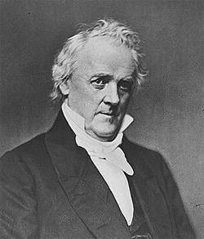
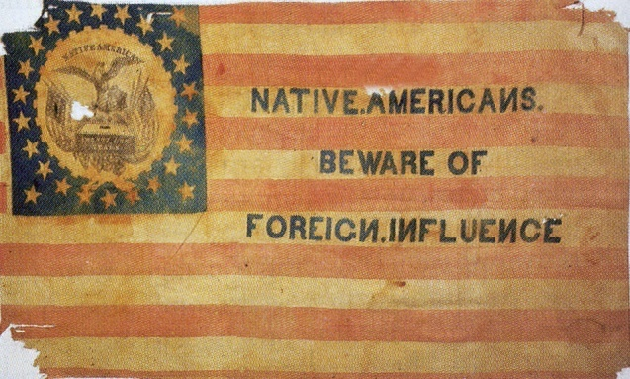
1856
Election of 1856
James Buchanan (D) v. John C. Fremont (R)
Like Pierce, Buchanan does not mend the relationship between North & South
3rd party forms called the “Know Nothings” –
- against immigrants, primarily located in the North

Slide 10
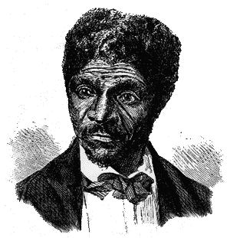
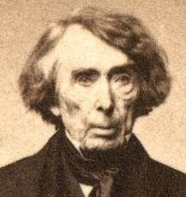
1857
Dred Scott v. Sandford
Supreme Court ruling:
African Americans were not citizens but property (could not sue)
Congress couldn’t keep slavery out of territories
The Missouri Compromise was unconstitutional

Slide 11
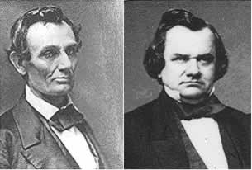
1858
Lincoln-Douglas Debates
7 total debates – both wanted US Senate seat for Illinois
“Freeport Doctrine” – Douglas: popular sovereignty could keep slavery out of territories.
Douglas is elected to the Senate

Slide 12
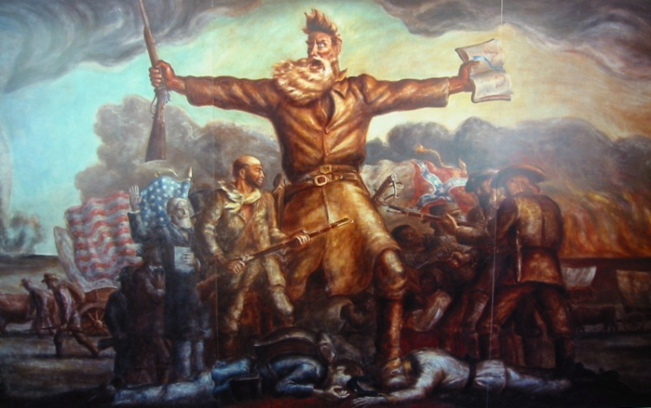
1859
John Brown’s Raid
An abolitionist – attempted a slave revolt at Harper’s Ferry, Virginia (federal arsenal)
Revolt fails, Brown is hanged
North honored him, South condemned him

Slide 13
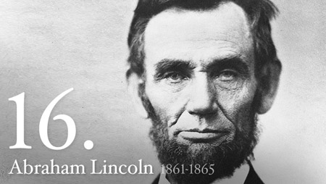
1860
ELECTION OF 1860
Abraham Lincoln (Republican)
James Breckinridge (Southern Democrat)
Stephen Douglas (Northern Democrat)
John Bell (Constitutional Unionist)
(Democratic party splits over slavery – LINCOLN WINS

Slide 14
1860

Slide 15
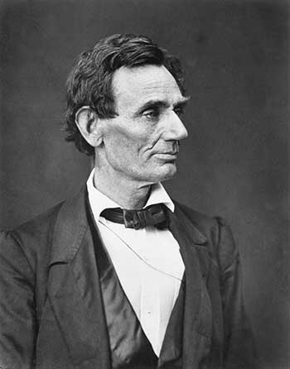
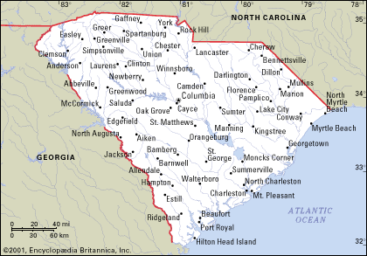
1860
South: “we will secede if Lincoln is elected”
Lincoln promises not to interfere with slavery where it existed…
December, 1860 – South Carolina secedes from the United States of America

Slide 16
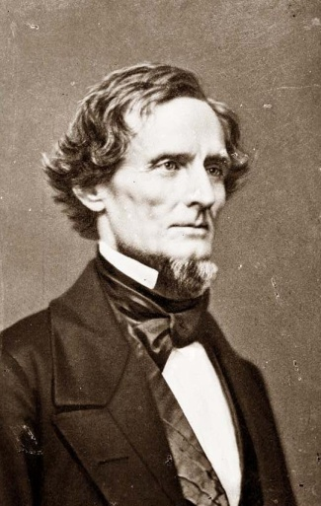
1861
Formation of the Confederacy
February, 1861: 6 more states secede (GA, FL, AL, LA, MS, TX) and form the Confederate States of America (CSA)
Elect Jefferson Davis as President

Slide 17
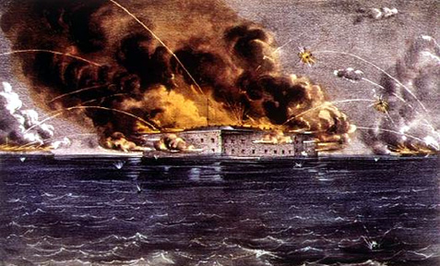
1861
Fort Sumter
April, 1861: Ft. Sumter, SC – CSA fires on Ft. Sumter off the coast of Charleston
First shots of the Civil War!
4 more states secede to join the Confederacy (VA, TN, AR, NC)
WAR!

Slide 18
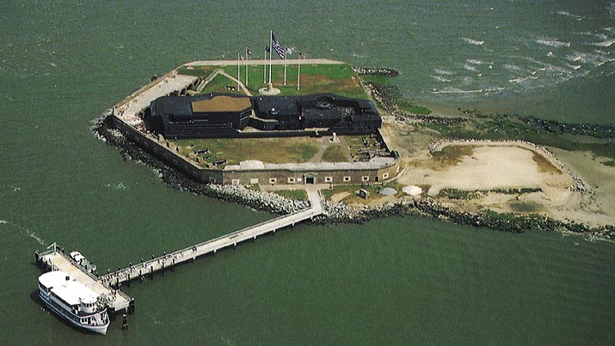
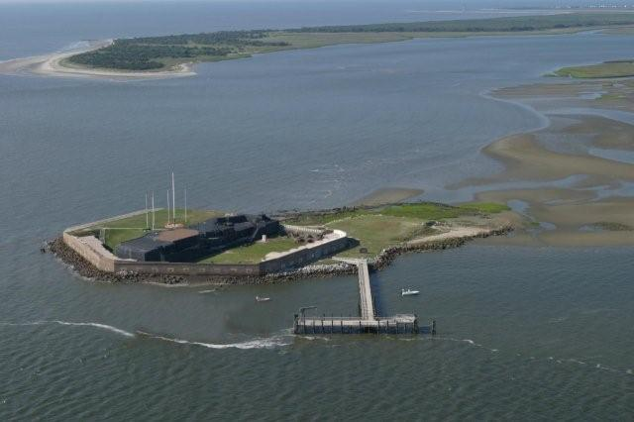

Slide 19
1861

