Slide 1
Chapters 20 & 21: World War II

Slide 2
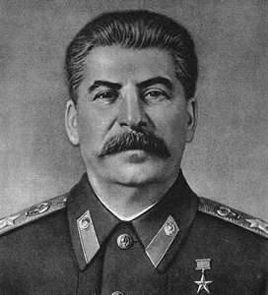
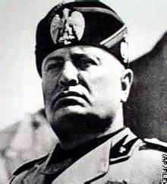
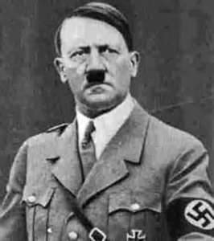
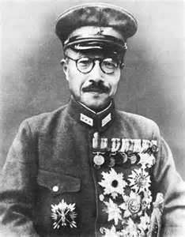
Tension in Europe
The rise of the dictators
Benito Mussolini – Italy
Joseph Stalin – Russia
Hideki Tojo – Japan
Adolf Hitler - Germany

Slide 3
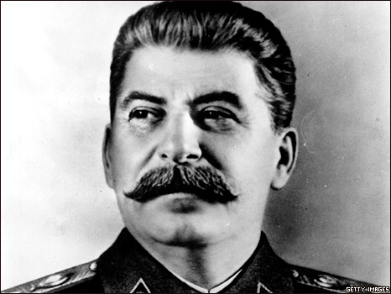
Joseph Stalin – Soviet Union
Goals as leader:
Make USSR an industrial power
Government control of all industry
Socialism dictated by the government
Stalin turned the USSR into a police state & arrested or killed anyone who did not promote his goals
The Great Purge: responsible for the death of 8-13 Million Soviet citizens

Slide 4
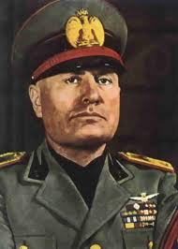
Benito Mussolini – Italy
Fascist dictator of Italy
“il duce”
Strong government control by the Brown Shirts
Made alliance with Nazi Germany (Rome-Berlin Axis)

Slide 5
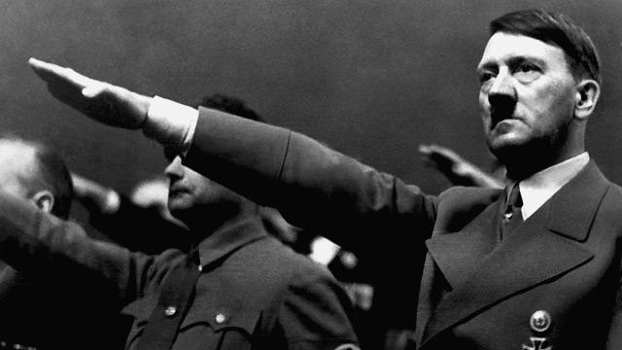
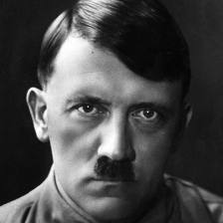
Adolf Hitler – Germany
Helped organize the Nazi Party after returning from World War I
Wrote Mein Kampf (My Struggle) while in prison, outlined his political ideas & antisemitism
Becomes leader of German government in 1933; takes on the role of a dictator
Goals: take back land from Treaty of Versailles, re-militarize, eliminate the Jewish population (“Final Solution”)

Slide 6
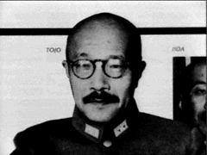
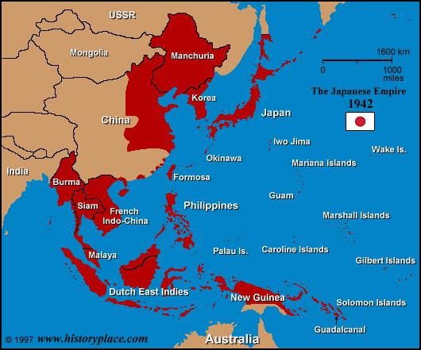
Emperor Hirohito & General Tojo Japan
Tojo held the majority of the power in Japan
Japan was building an empire – invaded China & Korea for natural resources
The League of Nations scolds Japan for its actions; Japan quits the league.

Slide 7
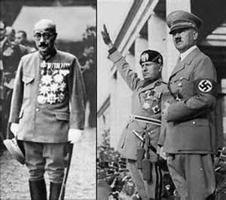
Axis Power
Germany / Italy / Japan

Slide 8
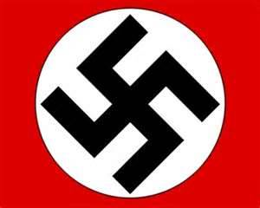
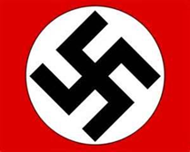
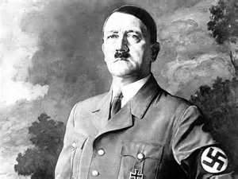
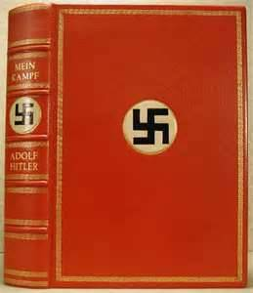
Adolf Hitler
Takes over Germany (1934)
Political Party – Nazi
Title – Der Fuhrer “The Leader”
Wrote:
Mein Kampf - “My Struggle”
Plan to take over the world
Key arguments
Called for the Unification of Germany
Believed in “The Aryan Race”
Blames Jews for everything

Slide 9
Young Nazi Germany
What was life like for young people in Nazi Germany?
https://www.youtube.com/watch?v=WVUAIPMsZ60

Slide 10
American Neutrality
Neutrality Act of 1935
Made it illegal for the U.S. to sell any arms (weapons) to any nation at war
Roosevelt believes in Internationalism:
Idea that trade between nations creates prosperity & helps prevent war

Slide 11
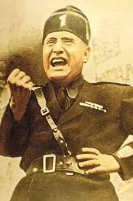
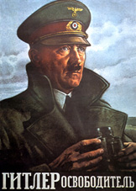
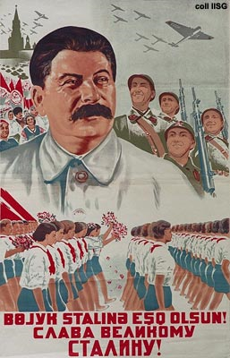
We’re in the Depression… What’s going on in Europe? Who cares!
European governments are being overthrown by totalitarian regimes
Fascism
Charismatic Dictator
Extreme nationalism (jingoism)
Private property with strong govt. control
Anti-communist
Nazism
Forceful Dictator
Jingoism & racism
Imperialism
Private property with strong govt. control
Anti-communist
Communism
State ownership of property
Class-less society (everyone is a part of the working class – equality)
Promote a worldwide revolution

Slide 12
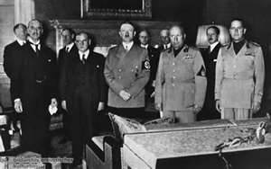
The Munich Conference (1938)
Was a peaceful meeting between:
Germany
Italy
France
Britain
Czechoslovakia
Goal:
Hitler wanted “Sudetenland” to become part of Germany
Other countries said Yes
Prevent War ………………………

Slide 13
Non-Aggression Pact (Aug. 1939)
Hitler & Stalin sign an agreement.
Soviet Union agrees not to attack Germany in the “hypothetical” event of Germany invading Poland
Shocking to the rest of the world: Nazism and Fascism are very different forms of government and the ideologies of the leaders clashed.
Nevertheless, the pact stands until Hitler violates it in 1941.

Slide 14
World War II
Began on September 1, 1939
Germany Invaded Poland
Then Britain & France Declare war on Germany
Italy attacks the Mediterranean
Fighting Style
Blitzkrieg – “Lightning War”
Used aircrafts/tanks/parachutes/radio to produce a highly mobile, fast moving army
Invented by Hitler

Slide 15
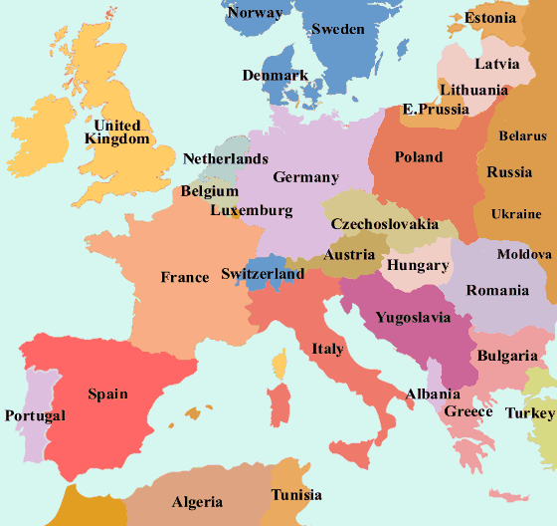

Slide 16
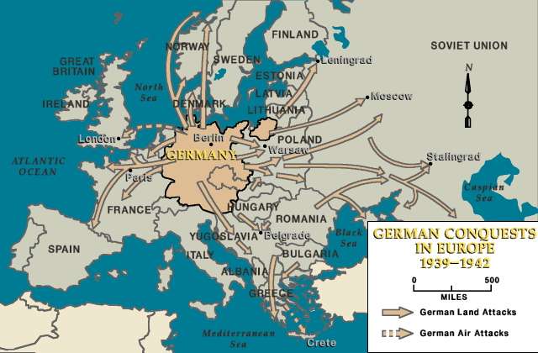

Slide 17
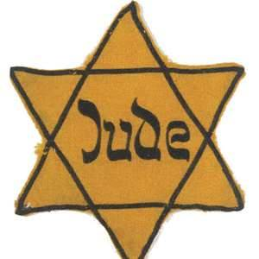
The Holocaust
Was the Nazi’s (Hitler) systematic mass slaughter of Jews and inferior peoples of Europe
2 Methods
Concentration Camps – prisons where individuals worked as slaves building war materials until they dropped dead
Extermination Camps – prisons where elderly/women/ children/& infirm would be sent to be killed

Slide 18
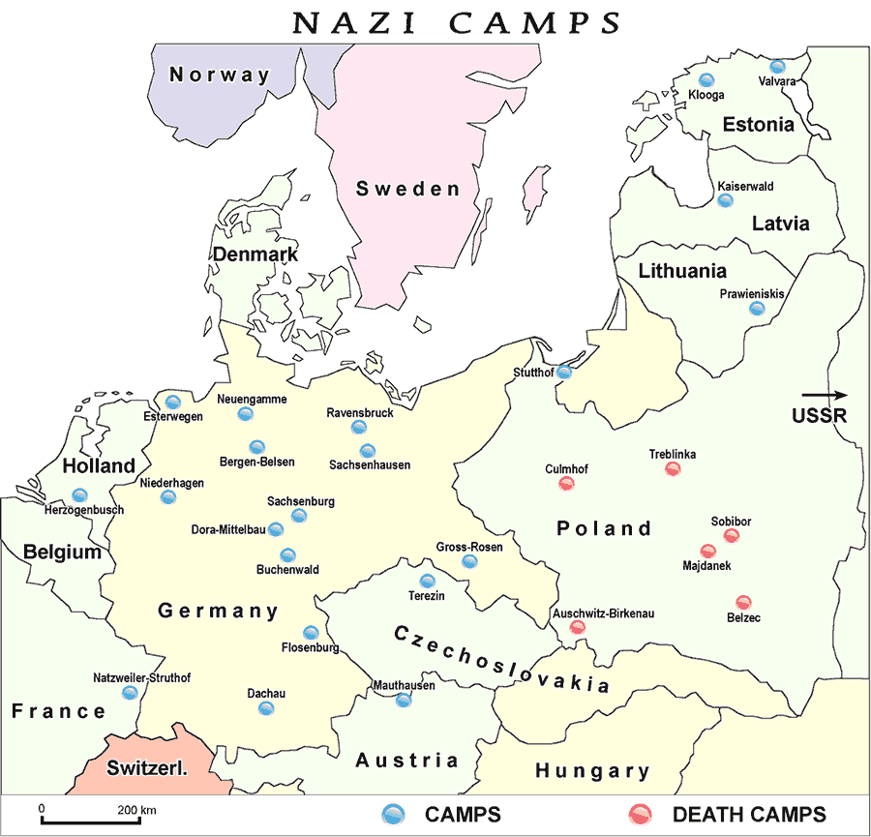

Slide 20
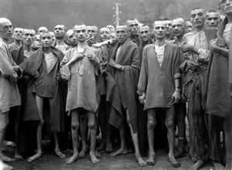
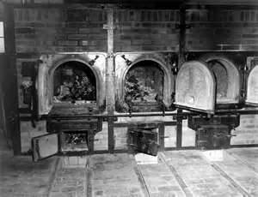
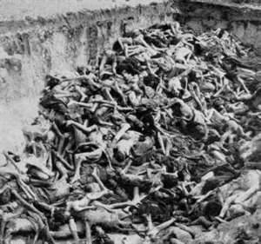
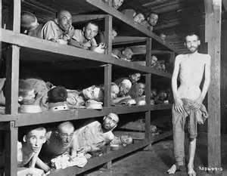
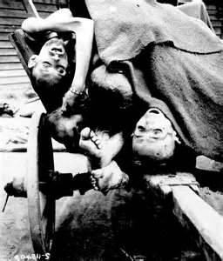
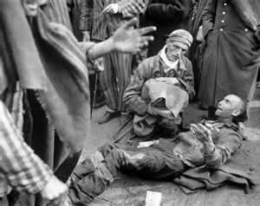
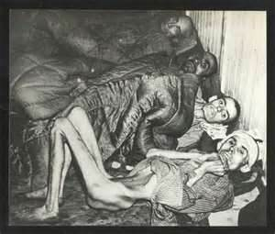

Slide 22
First Newscast Report Played in U.S. showing horrors of death camps
https://www.youtube.com/watch?v=SwSGhyI7mVg
In color-liberation video
http://www.history.com/topics/world-war-ii/the-holocaust/videos/concentration-camp-liberation

Slide 23
The End
When Germany began losing the war they took the healthy Jews and forced them to march back as they retreated, nearly 250,000 would die in these marches
By the wars end the allies had discovered nearly 200,000 Jews left in the camps
The Allies set up Dislocated Persons Camps to house the Jews till they found places for them to settle, as many of them were scared to return to their homes
The last camp would not close till 1957
In all nearly 6 million died in the Holocaust

Slide 24
American Involvement in WW II
FDR believed in “4 Freedoms”
Freedom of: Speech/Worship
Freedom from: Want/Fear
Lend-Lease Act
Allowing the U.S. to lend or lease arms to any country
Atlantic Charter
Agreement between U.S. & Britain agreeing on a postwar world of democracy, nonaggression, free trade, economic advancement, & freedom of the seas

Slide 25
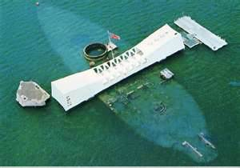
December 7, 1941
The Empire of Japan attacked the U.S. naval base @ Pearl Harbor
Destroyed 21 Ships
Wounded 1,178
Killed 2,403
Result
The Next day Congress declared war on Japan
Germany then declared war on the U.S.

Slide 26
Factors Leading to Attack
US embargos on Japan after attacks on French Indochina (Vietnam, Laos, Cambodia), Which came on top of other attacks into China
Without US oil supply they would run out within two years
Purpose of Attack
To protect Japans movement to attack Dutch East Indies for their oil resources
Delay Americas ability to respond till they have dug in and built up their navy more
Most importantly they thought it would destroy Americans moral and will to fight the war

Slide 27
USS Arizona forward magizine explosion

Slide 28
NAS Kaneohe Bay after attack

Slide 31
Pearl Harbor Attack
In Color—Rare Footage—Only Existing
https://www.youtube.com/watch?v=3e99lfmmDN0

Slide 32
Supreme Court Case
Japanese Exclusion and Internment Camps
Korematsu
vs.
The United States (1944)
https://www.youtube.com/watch?v=gfxaSrMQtME

Slide 33
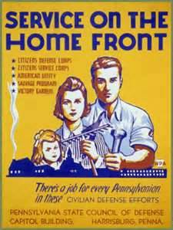
“Awoke a Sleeping Giant”
WW II reinvigorated the American economy
Industries changed from consumerism to War-ism
Created over 20 million jobs
Office of Price Administration (OPA)
Set prices & wages
Regulated speed limit to 35mph
Rationed food – Blue Points / Red Points
Victory Gardens
Scrap Drives
Rubber/tin/aluminum/steel/pots/car bumpers

Slide 34
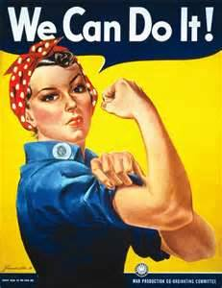
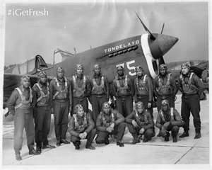
Key Contributors
Women
Over 400,000 will work for the war effort
Over 2.5 million will work in factories
“Rosie the Riveter”
African Americans
Tuskegee Airmen (332nd Fighter group)
Flew over 200 missions – never lost a single fighter
Native Americans
Used old Cherokee language for radio communication so Axis Power couldn't interpret orders

Slide 35
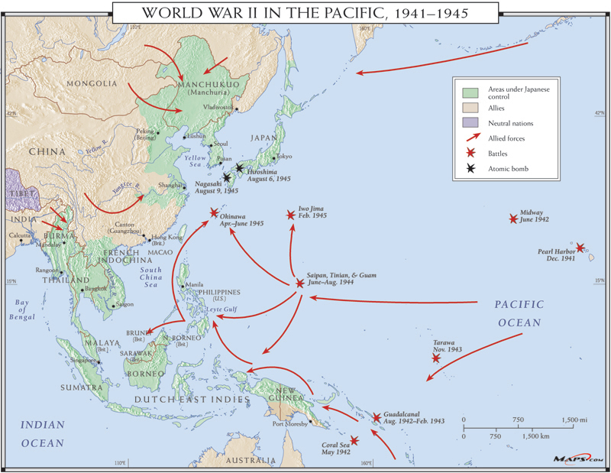
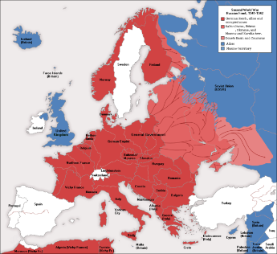
World War II
The Pacific
Europe

Slide 36
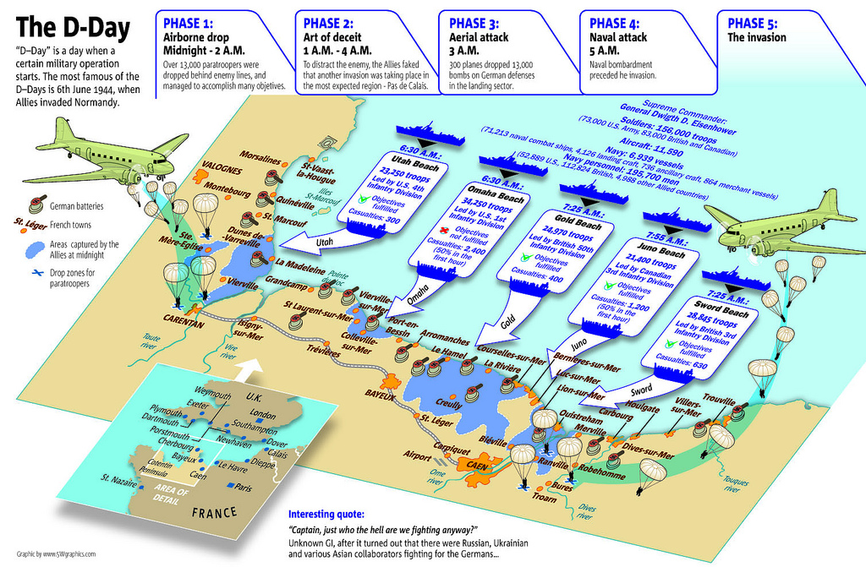
“D - Day”
Allied forces land at Normandy (France)
Occurred: June 6th 1944
Call Sign: “Operation Overlord”
Used:
Over 7,000 ships
Over 100,000 soldiers
23,000 paratroopers
Lost:
2,500 were killed

Slide 37
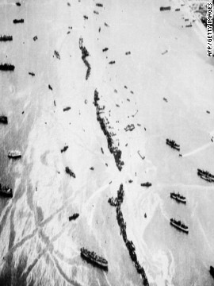
D-Day Facts
An aerial view shows 32 intentionally-sunk American merchant ships, known as Liberty Ships, which served as both a breakwater and offshore anti-aircraft platforms during the invasion.
https://www.youtube.com/watch?v=lDZs442oqxA

Slide 38
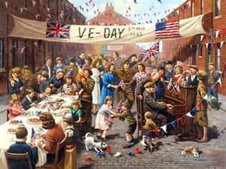
European Theater
Turning point battle
Battle of the Bulge (December 1944 – January 1945)
Last German offensive to try and break Allied Lines
Failed - Slowly pushed back to Berlin
Hitler Commits Suicide
On April 30, 1945
V - E Day “Victory in Europe”
On May 8, 1945 Germany surrendered

Slide 39
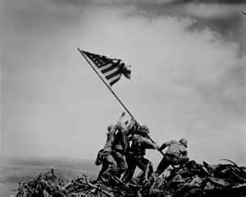
Pacific Theater
Turning Point battle
Battle of Midway (June 4 1942)
The U.S. must respond from Pearl Harbor
Stopped the Japanese advance in the pacific
Destroyed heart of Japanese fleet
Battle of Iwo Jima (February 19, 1945)
6,800 Marines died
Plan to Win
“Island Hopping”
American forces would “hope” from island to island slowing pushing the Japanese back to Japan
https://www.youtube.com/watch?v=m5LUDLuYkdU

Slide 40
Pacific Theater
The Manhattan Project
Built a Atom Bomb
Created by: Robert Oppenheimer
On August 6, 1945
The U.S. dropped a Atom bomb (Little Boy) on Hiroshima
On August 9, 1945
The U.S. dropped a Atom bomb (Fat Man) on Nagasaki
http://www.dailymotion.com/video/x259uwy_hiroshima-nuclear-atomic-bomb-usa-attack-on-japan-1945_people
On August 15, 1945
V – J Day “Victory In Japan”
Japan Surrenders – World War II is over
https://www.youtube.com/watch?v=BmIBbcxseXM

Slide 42
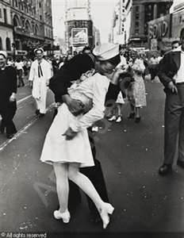
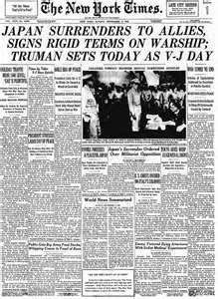
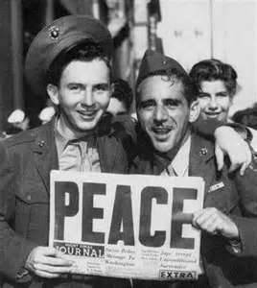
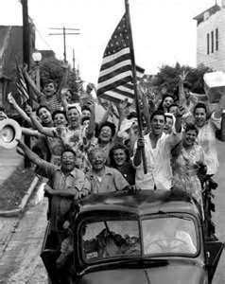

Slide 43
Plan for a Better / Peaceful World
Representatives from 39 nations met in Washington D.C. to prevent another War
Created the United Nations (UN)
1. All nations would receive 1 vote
2. Security Council (Britain/France/China/Russia/U.S.)
3. Drafted the Universal Declaration of Human Rights

Slide 44
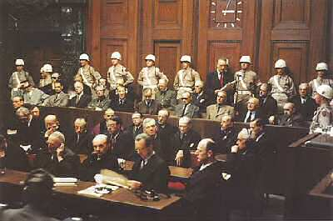
Punishing the Axis
International Military Tribunal (IMT)
Created by: U.S./Britain/France/Russian
Held trials to punish Germany and Japan for war crimes
Nuremburg Trials
Punish 21 Nazi leaders
(originally 24)
3 were acquitted
114 were given life in prison
36 were sentenced to death

