Slide 1
Chapter 19: Roosevelt & the New Deal

Slide 2
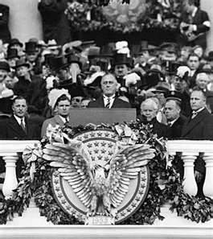
Election of 1934
Elected:
Franklin Delano Roosevelt (FDR)
Democrat
Promised a “New Deal” for America ……….

Slide 3
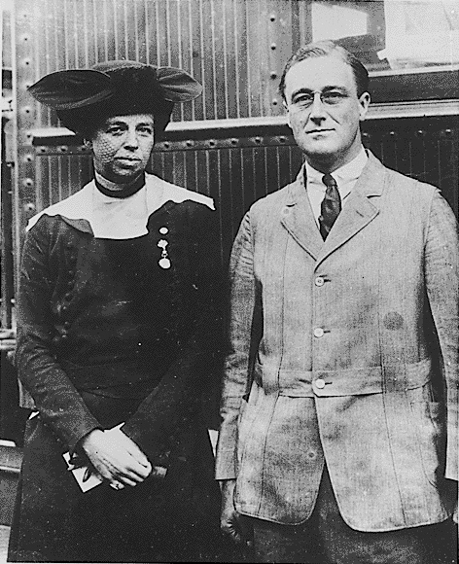
Franklin and Eleanor
Franklin Roosevelt
Appealing blend of cheerfulness, optimism, and confidence
An effective communicator (ex. fireside chats)
A reform-minded Democrat
Believed the government could solve economic and social problems
Eleanor Roosevelt
“Eyes and ears” of her husband
Directed efforts to solve several major social issues (ex. lynching of African Americans)
Wrote her own newspaper column
Had the trust and affection of many Americans

Slide 4
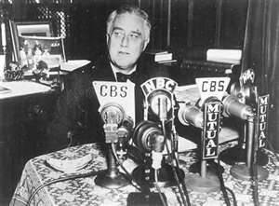
“The Hundred Days”
FDR pushed 15 bills through Congress to become law
Became known as The “First New Deal”
Nickname – Alphabet Soup
“Fireside Chats”
Goal: help relax / calm Americans
get them to re-trust /re-invest in the banks
Needs banks to run to fix economy
Banks closed for 100 days
Complete success
Banks re-opned!

Slide 5
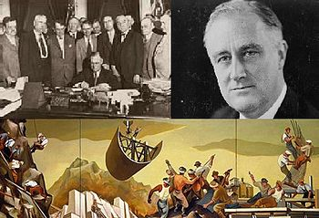
FDR’s plan to get the US out of the Depression
The New Deal
Relief
Recovery
Reform

Slide 6
The 1st New Deal
Initials | Programs | Purpose | Result
AAA
CCC
PWA
CWA

Slide 7
The 1st New Deal
Initials | Program | Purpose | Result
NIRA / NRA
HOLC
FERA
TVA

Slide 8
The 1st New Deal
Initials | Program | Purpose | Result
FHA
FDIC
SEC

Slide 9
The 1st New Deal
Success
Got Congress to pass new laws
Showed the presidents ability to experiment
Banks re-opened
People were able to keep homes / farms
Created a lot of jobs
Restored hope in Americans

Slide 10
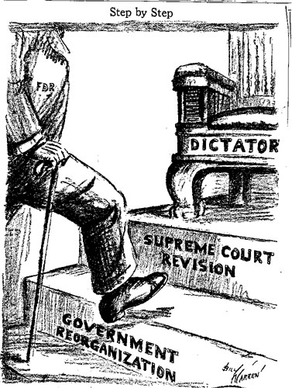

Slide 11
The 2nd New Deal
Initials | Program | Purpose | Result
WPA
NYA
REA

Slide 12
The 2nd New Deal
Initials | Program | Purpose | Result
SSA
The Wagner Act NLRA
New AAA
Fair Labor Standard Act

Slide 13
Results of the New Deal’s
Helped end the Great Depression
The size of the federal govt. GREW EXPONENTIALLY
Americans now expect help from the government regularly
DID NOT fully end the depression – WWII brought us out completely

Slide 14
America The Story of US
http://www.bing.com/videos/search?q=america+the+story+of+us+episode+9&qs=n&form=QBVR&pq=america+the+story+of+us+episode+9&sc=4-33&sp=-1&sk=#view=detail&mid=5C5D2EDCE7797C4987185C5D2EDCE7797C498718

