Slide 1
Chapter 18: The Great Depression

Slide 2
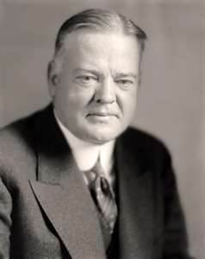
Causes of the Great Depression
The Roaring 20’s
Massive economic growth – Consumerism
High employment – assembly lines
Easy available credit
Low cost stock options
Partial ownership in a business
Newly elected President Herbert Hoover
Said “I have no fear for the future of our country, Its bright with hope” …………………

Slide 3
What happens to the economy when consumers buy everything they need??????

Slide 4
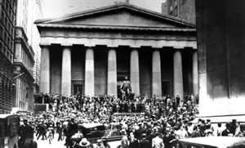
Causes of the Great Depression
Once the market ran out of consumers
Investors sold off their stocks
The Stock Market Crashed
On October 29, 1929 (Black Tuesday)
16 million shares were sold
Lost about $15 billion
Banks Closed
Banks had loaned out over $6 billion to investors
Investors didn’t have any money
No one had available money

Slide 5
Causes of the Great Depression
Low Interest Rates
Companies borrowed and spent more than necessary
Overproduction
Companies made more than could be sold
Uneven distribution of wealth
High Tariffs
paying off WW I debt
Stock Market speculations
Investors unwilling to gamble – sold shares

Slide 6
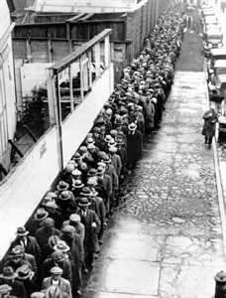
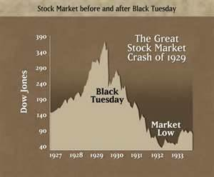
The Great Depression
By 1930 – 1,352 banks closed
By 1932 – more than 30,000 companies closed
By 1933 – 9,000 banks closed
By 1933 – more than 12 million workers unemployed

Slide 7
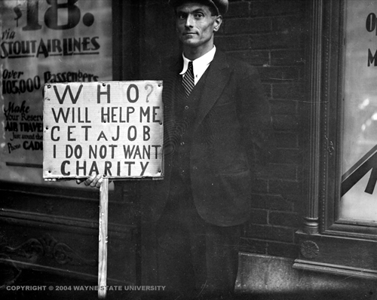
Great Depression Stats
Average rate of unemployment in 1929: 3.2% in 1930: 8.9% in 1931: 16.3% in 1932: 24.1% in 1933: 24.9%

Slide 8
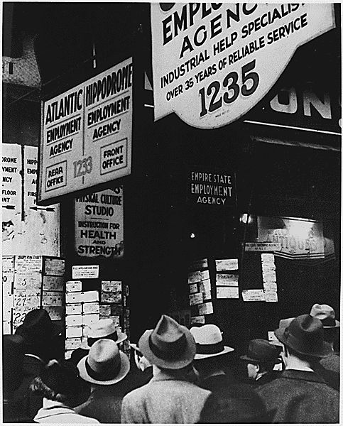
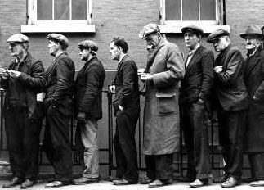
Many waited in unemployment lines hoping for a job.

Slide 9
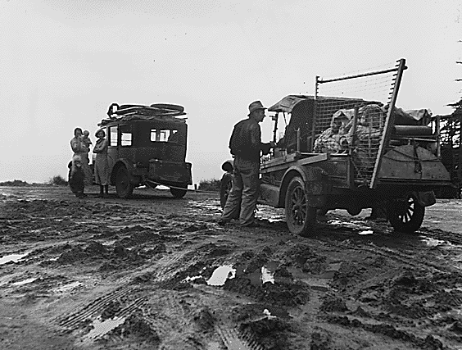
Some families were forced to relocate because they had no money.

Slide 10
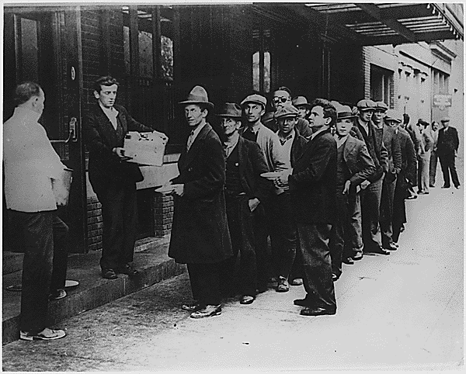
People in cities would wait in line for bread to bring to their family.

Slide 11
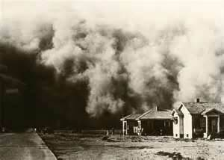
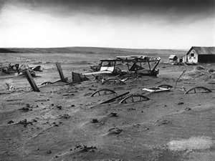
The Dust Bowls
Covered over 100 million acres (70% of U.S.)
In 1932 alone there were 14 dust storms
Caused by
Unused fields
Terrible drought

Slide 12
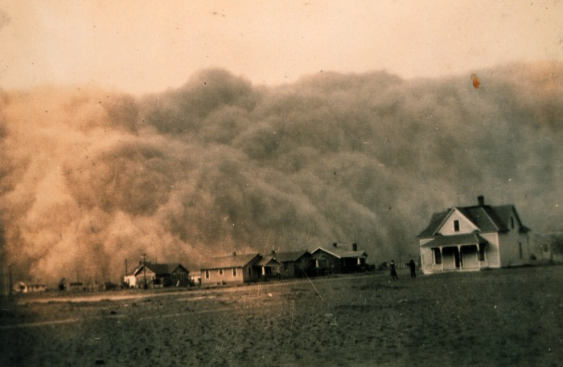

Slide 13
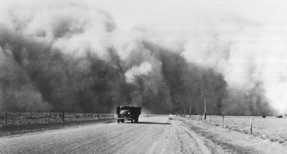

Slide 14
Hoover vs. The Depression
Created: Public Works
government funded building projects
Asked the Federal Reserve to print more $$$$
Answer = No
Created: The National Credit Corporation
Collect money to help banks continue lending
Created: The Reconstruction Finance Corporation
Loans for business
$238 million to160 banks / railroads / loan organizations

Slide 15
Hoover vs. The Depression
Hoover was adamantly against relief
$ given to impoverished families
Aid should come from private charity
Believed in “Rugged Individualism”
Created an angry nation
500 citizens of Oklahoma City raided a grocery store
1,200 citizens marched on Washington D.C.
Veterans marched from Oregon to Washington D.C.
Grew to over 1,000

Slide 16
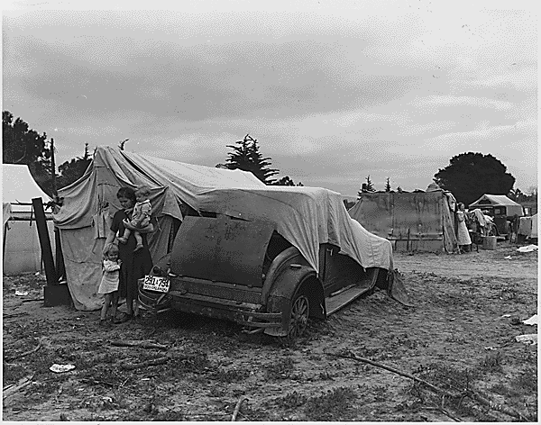
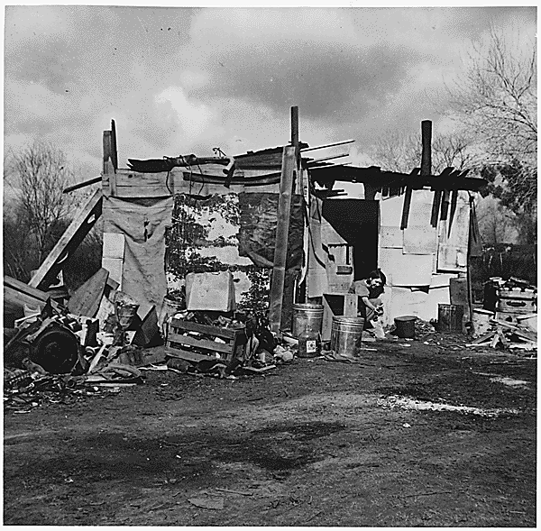
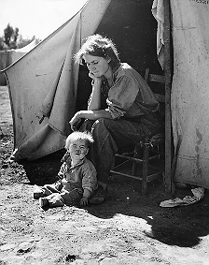
“Hooverville”
Some families were forced to live in shanty towns
A grouping of shacks and tents in vacant lots
They were referred to as “Hoovervilles” because of President Hoover’s lack of help during the depression.

Slide 17
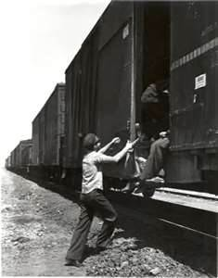
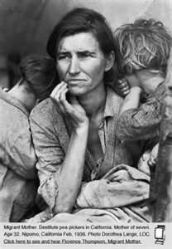
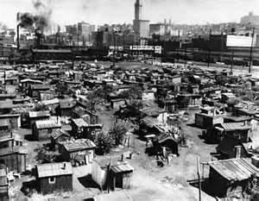
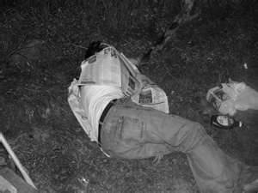
Hoover-villes / Hoover Blankets

