Slide 1
Chapter 17: The Jazz Age
Sections: 1 & 2 Economic Growth of the 20’s

Slide 2
Then & Now ………..
The United States had a large national debt, and many were worried that it could not recover from a large recession

Slide 3
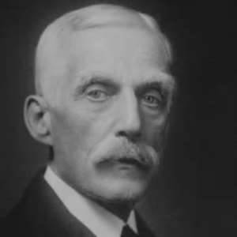
The Solution
President Harding chose
Andrew Mellon as his Secretary of Treasury
Mellon’s Plan
Balance the budget
Reduce government debt
Cut taxes
Invented: Supply-side Economics
Theory that lower taxes would
boost the economy as businesses
and individuals invest their money, thereby creating higher
tax revenue

Slide 4
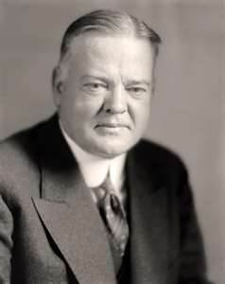
The Solution
President Harding chose
Herbert Hoover as his secretary of Commerce
Invented: Cooperative Individualism
Idea that businesses should form trade associations that would voluntarily share information with the federal government

Slide 5
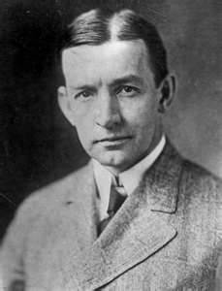
The Solution
To increase foreign trade
U.S. Diplomat Charles G. Dawes
Created the Dawes Plan 1924
Goal:
help Germany pay off war Reparations
Agreement:
American banks would make loans to Germany that would enable it to make reparations payments.
Britain & France would accept less in reparations and pay back more on their war debt

Slide 6
Military Reforms
5 Power Naval Limitation Treaty
Was an agreement between the U.S. / Britain / France / Japan / Italy that they would stop building new warships for 10 years
Why ?????????????????
Kellogg-Briand Pact
Was a “pact” stating that all signed nations (14) agreed to abandon war and settle a disputes by peaceful means

Slide 7
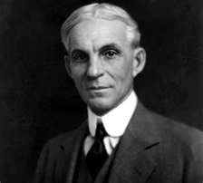
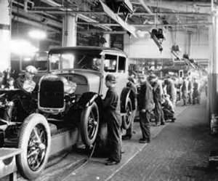
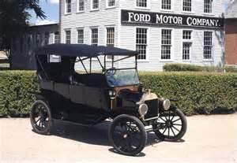
New Industries
Henry Ford
Invented the Assembly Line:
Dividing big operations into simpler tasks and cutting out unnecessary motions
Lead to the creation of: the “Car”
mass production of everything

Slide 8
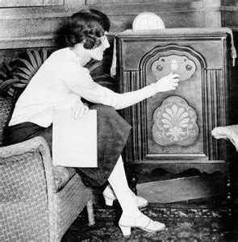
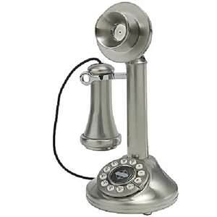
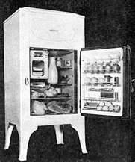
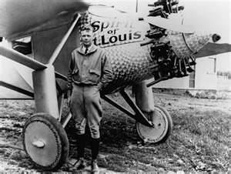
New Technologies

Slide 9
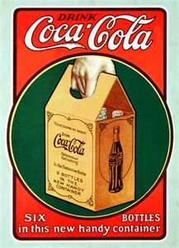
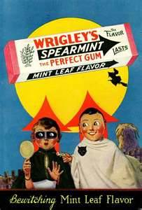
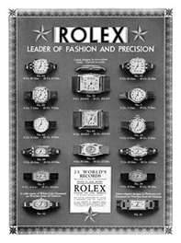
The Consumer Society
Created by:
Easily Available Credit
Mass Advertisement

Slide 10
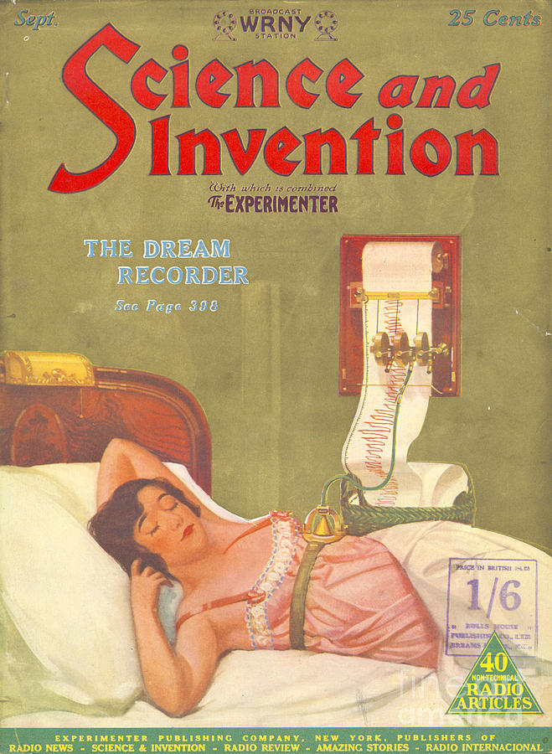
Inventions of the 1920s
http://www.history.com/topics/roaring-twenties/videos/1920s-inventions

Slide 11
Chapter 17: The Jazz Age
Sections: 4 & 5 American Culture

Slide 12
American Culture
Was re-defined in the 1920’s by:
Mass Media
Radio / movies / newspapers / magazines aimed to reach a wide audience
Created = Pop Culture

Slide 13
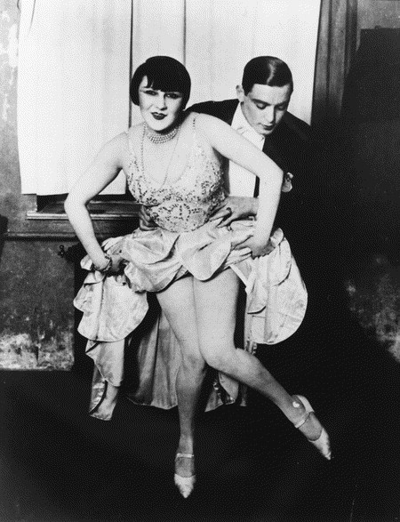
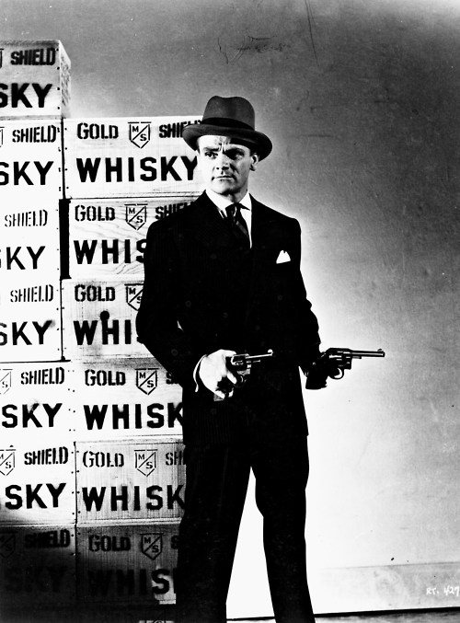

Slide 14
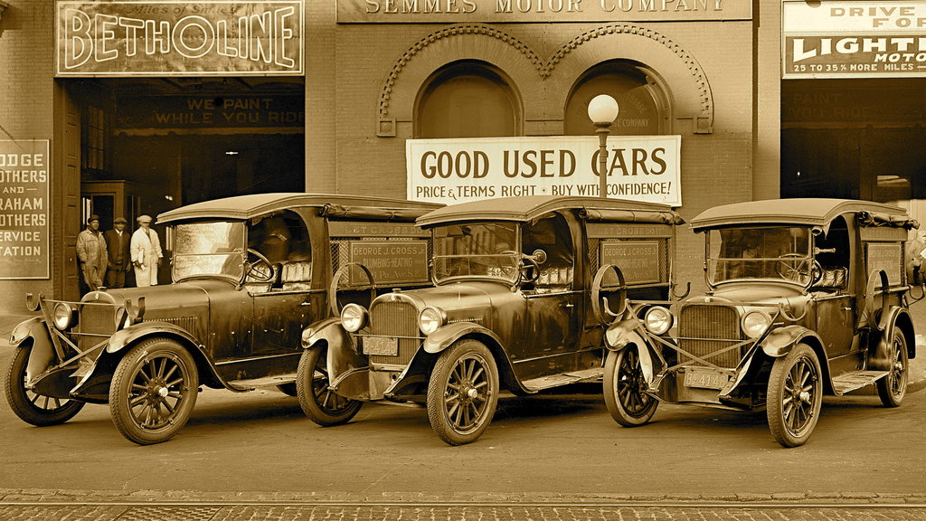
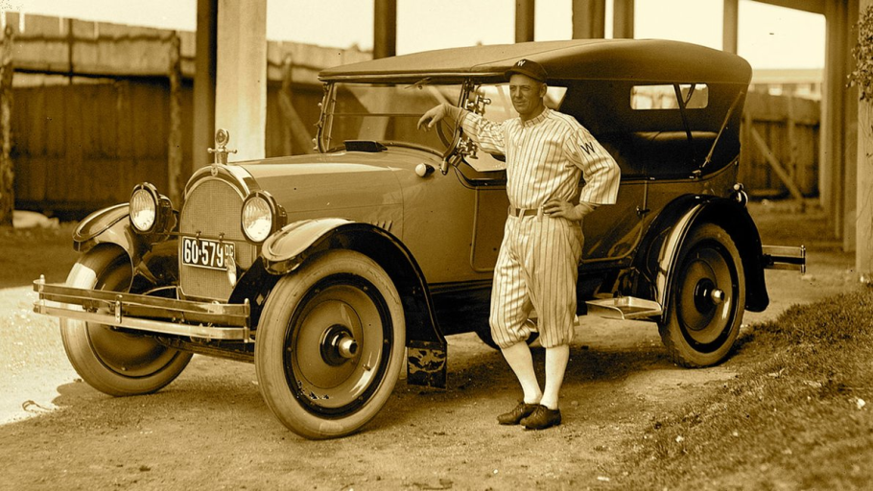
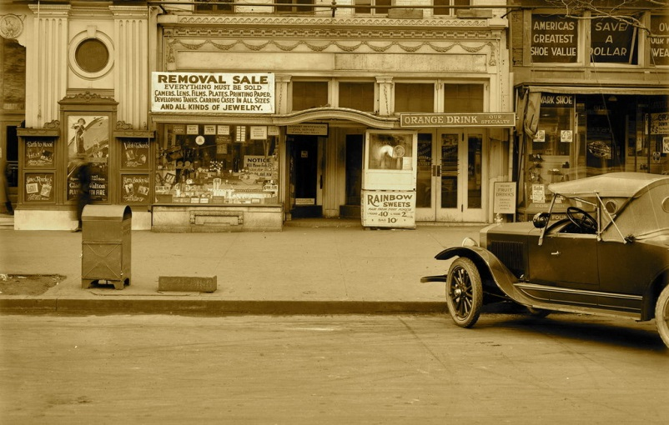

Slide 15
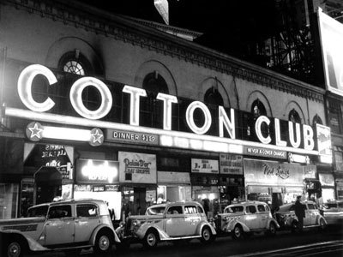
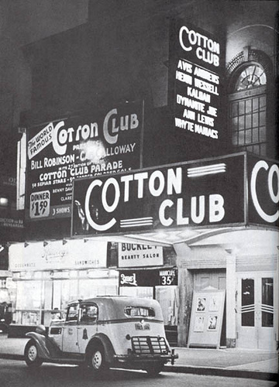
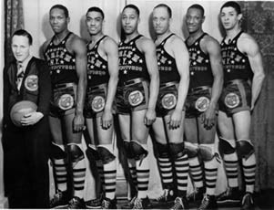
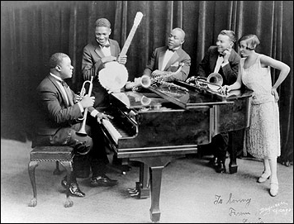
V
V

Slide 16
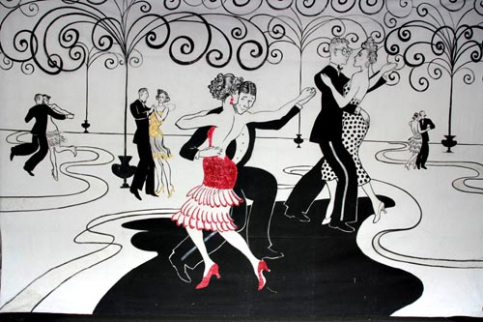

Slide 17
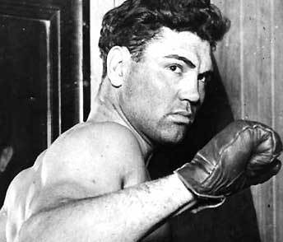
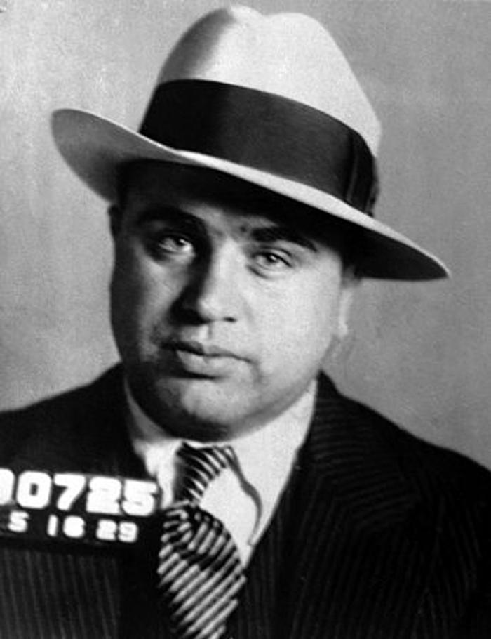
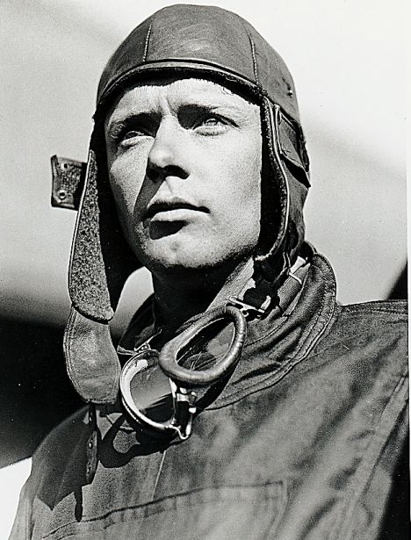
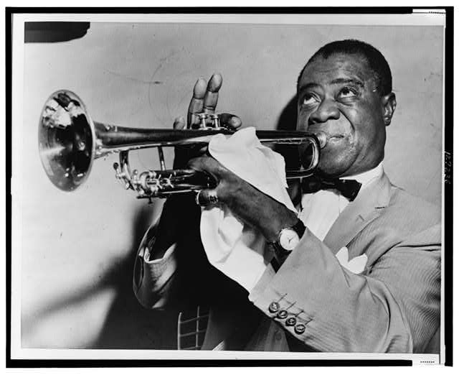

Slide 18
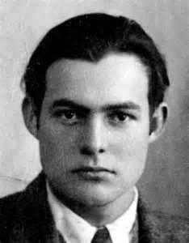
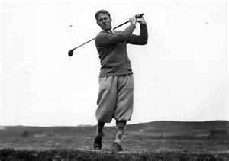
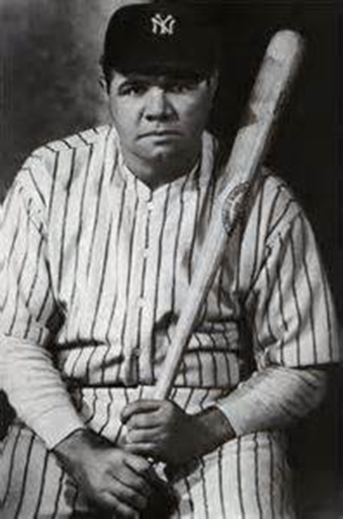
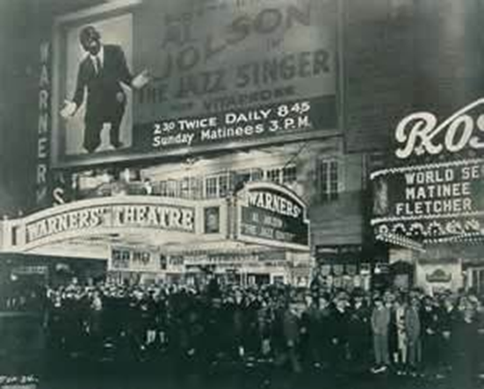
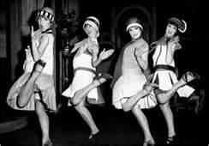

Slide 19
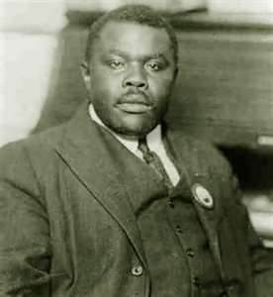
The Harlem Renaissance
Was an African American cultural movement that helped create a sense of identity and pride to African Americans
Created
Jazz Music / The Blues
Marcus Garvey wrote:
“Negro Nationalism” – glorified black culture & traditions
Inspired by Booker T. Washington

