Slide 1
Chapter 15: The Progressive Movements
Sections 1 & 2: Reform

Slide 2
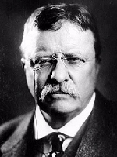
Who were Progressives?
Middle Class, Urban Dwellers, Well-Educated, Reformers
Goal: Improve life in the industrial age
SUPPORTERS:
Theodore Roosevelt
“Muckrakers” - writers of the era who exposed areas of society in need of reform
Presidents Taft and Wilson

Slide 3
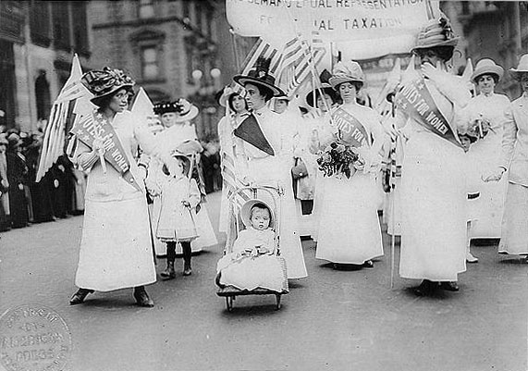
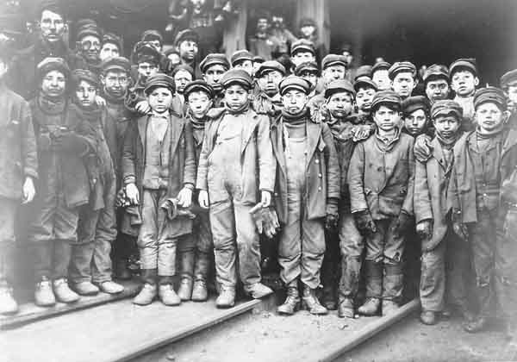
Social Reforms
Suffrage
(19th Amendment)
Women’s right to vote – Seneca Falls Convention
Child Labor
“The Bitter Cry of the Children” (Muckraker)
Showed that thousands of 9 & 10 year olds were working 10 hour days and getting paid 60 cents

Slide 4
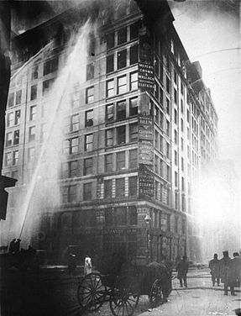
Social Reforms
Health & Safety Codes
The Triangle Shirtwaist Fire
Killed 150 women
Changed -Working Conditions
Workers’ Compensation Law: Life Insurance
Workers Comp
Building Codes set standards on: lights/air/room size/
sanitation/fire escapes

Slide 5
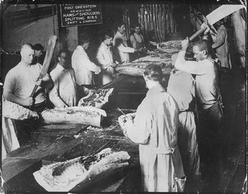
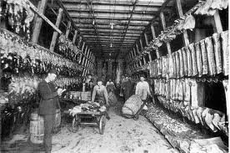
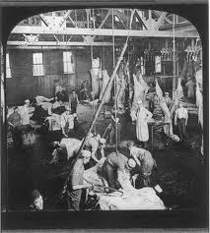
Social Reforms
Health & Safety Codes
“The Jungle”
By: Upton Sinclair (Muckraker)
About: the horrors of the meatpacking plants
Goal: Change the food sanitation system
Created: The Food & Drug Administration (FDA)

Slide 6
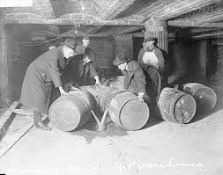
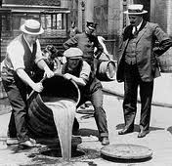
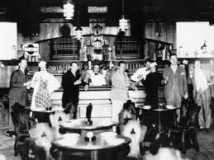
Social Reforms
Prohibition (18th Amendment)
Law that banned the manufacture, sale, and consumption of alcohol
“alcohol was reason for many of America’s problems”
“Speakeasy”

Slide 7
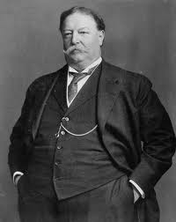
Taft Administration
William Howard Taft
Hand picked by Roosevelt to be his successor to the presidency ………….. BAD CHOICE
Foreign Policy Plan
Dollar Diplomacy = if the U.S. increased business in Latin America it could rise out of poverty
Built the Children’s Bureau
Deals with: child abuse / adoption / foster care

Slide 8
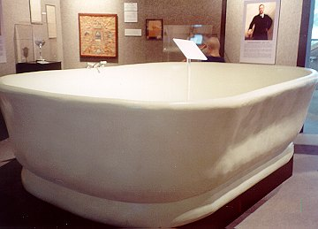

Slide 9
Chapter 15: The Progressive movement
Section 3: The Wilson Years

Slide 10
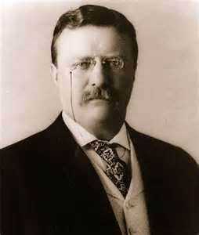
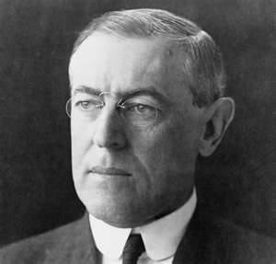
Election of 1912
Theodore “Teddy” Roosevelt | Woodrow Wilson
Progressive Party “Bull Moose” | Democratic
New Nationalism | New Freedom
Protect women/children in labor force Workers compensation | Destroy Monopolies Increase competition

Slide 11
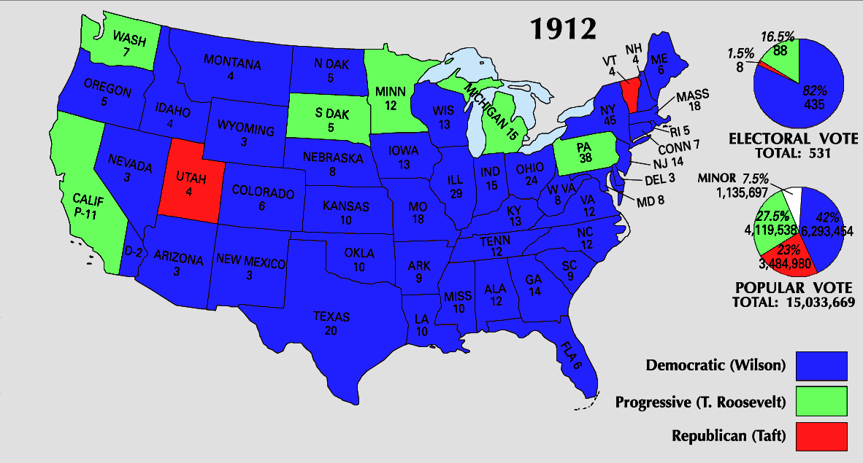

Slide 12
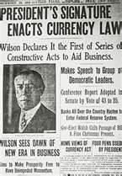
Wilson’s Reforms
Reduce Tariffs
Lower price = more competition = better product
Income Tax (16th Amendment)
Tax on individuals earnings
Federal Reserve System
Federal Bank
National supervision of the banks
Banks were notorious for crashing,
and people lost the money they had saved.

Slide 13
Wilson’s Reforms
Clayton Antitrust Act
Outlawed certain practices that restricted competition
Keating-Owen Child Labor Act
Prohibited the employment of anyone under age of 14 to work
NAACP
National Association for the Advancement of Colored People
http://www.youtube.com/watch?v=tfUYi8ehLMk

Slide 14
Was the Progressive Movement a Success?
Although all of the problems Progressives sought to improve were not solved, the movement sparked changes that greatly improved American politics, labor, and society.
Evidence:
16th Amendment: income tax
17th Amendment: direct election of Senators
18th Amendment: prohibition of alcohol
19th Amendment: women’s suffrage

