Slide 1
Chapter 13: Urban America
Section 1 & 2: Immigration and Urbanization

Slide 2
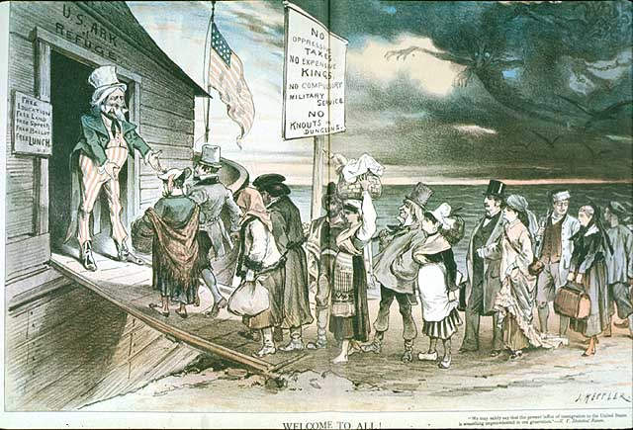
Immigration
Why come to the U.S. ???????????

Slide 3
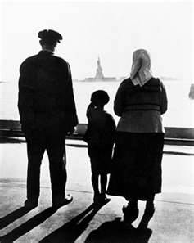
Immigration
Reasons:
Religious Freedom
Political Freedom
Avoid Military Service
A lot of Cheap Land
A lot of Jobs
Opportunity for Social Advancement

Slide 4
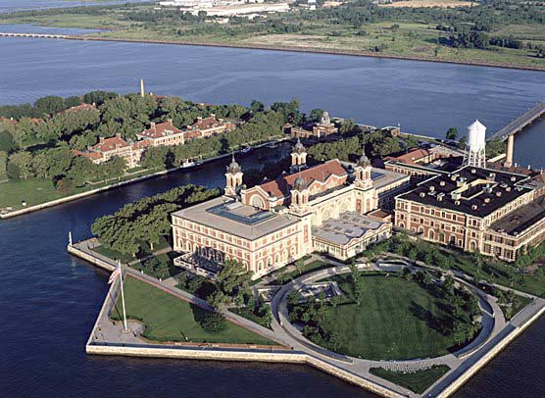
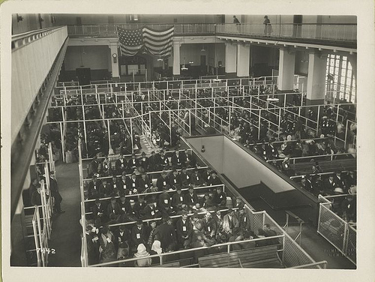
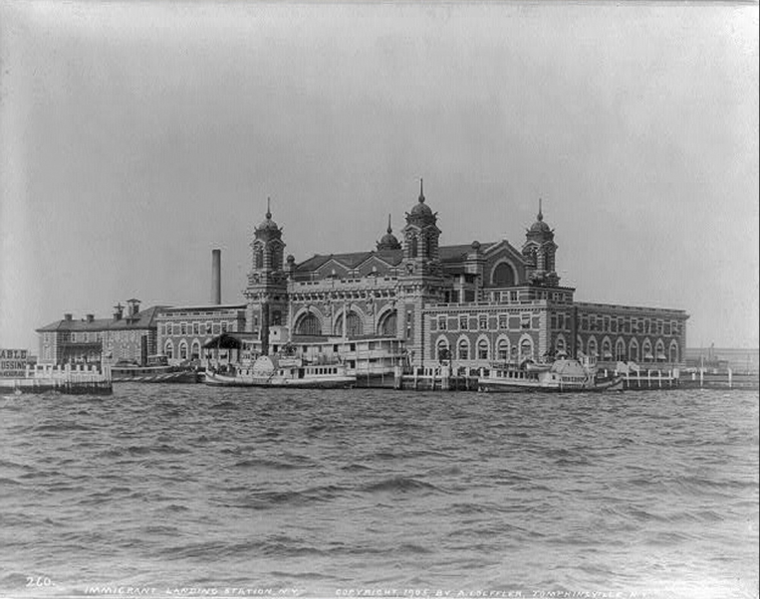
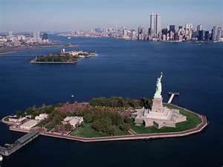
Inspection Checkpoints
Europeans: Ellis Island (New York)

Slide 5
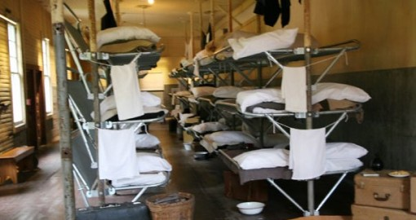
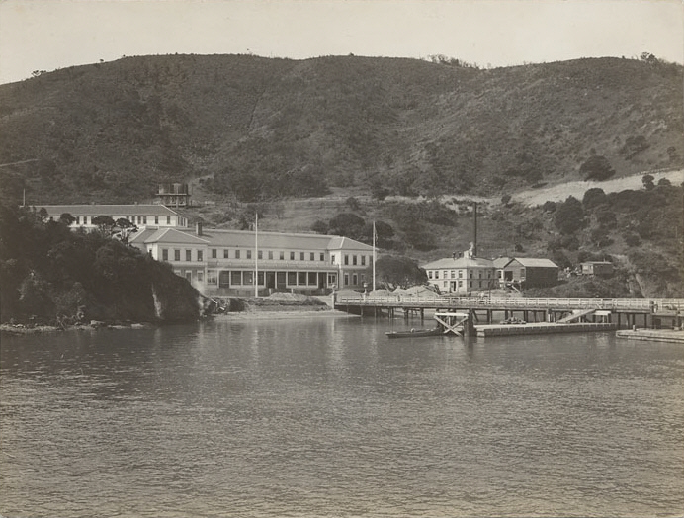
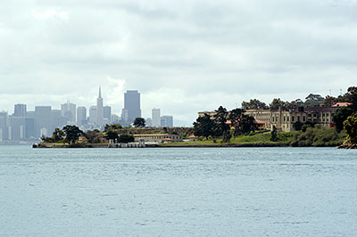
Inspection Checkpoints
Asians: Angel Island (San Francisco)

Slide 6
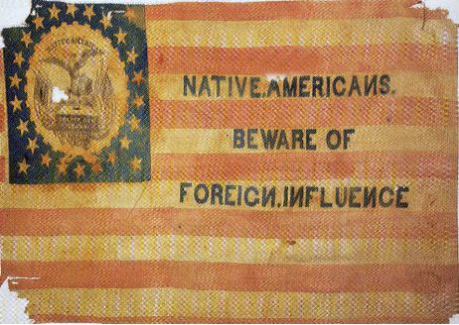
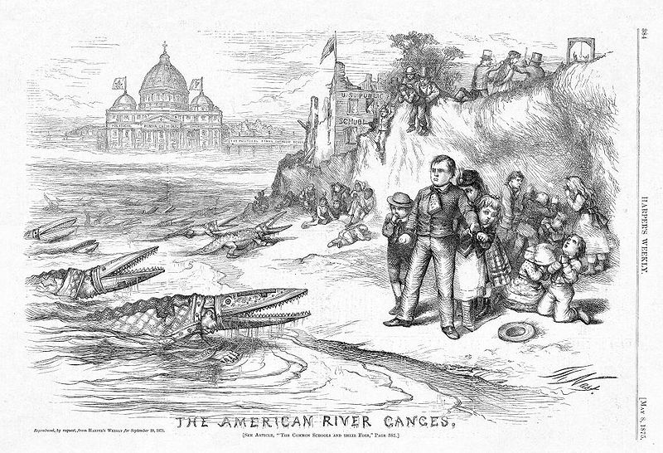
Nativism
Is:
An extreme dislike of immigrants by native born people
Because of:
Take American jobs for lower wages
Huge Catholic population would drown out Protestants

Slide 7
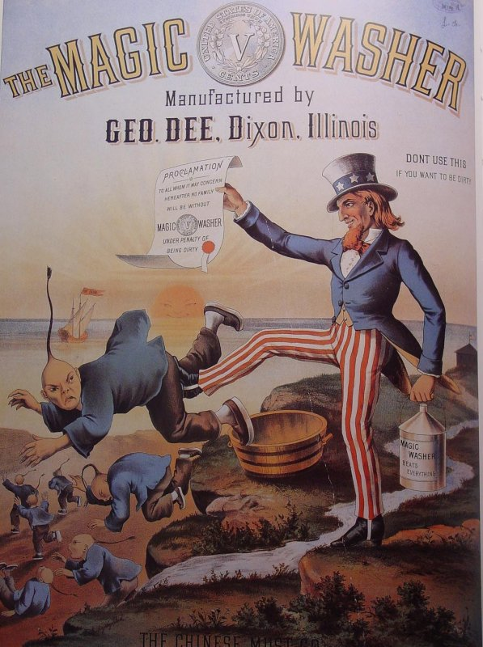
Chinese Exclusionary Act (1882)
Banned all Chinese immigration for 10 years
All Chinese heritage students must attend racially segregated schools

Slide 8
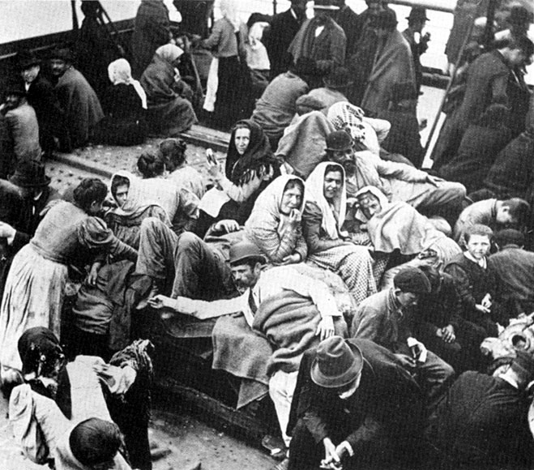
“Immigration Boom”
U.S. Population:
1865 = 10 million
1870 = 30 million
New York City:
1860 = 800 thousand
1900 = 3.5 million
Result:
Ran out of land …… “skyscrapers”

Slide 9
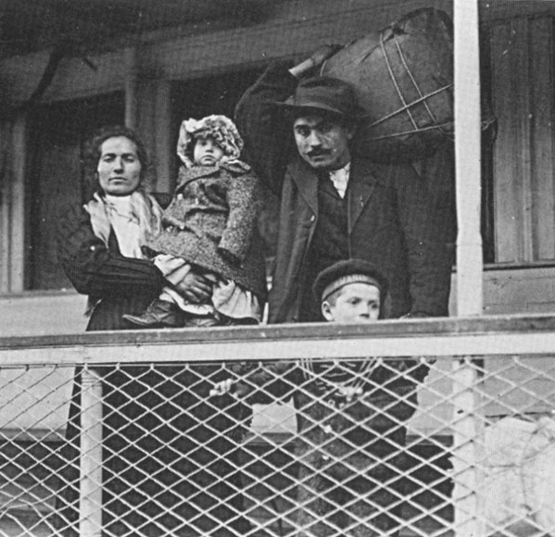
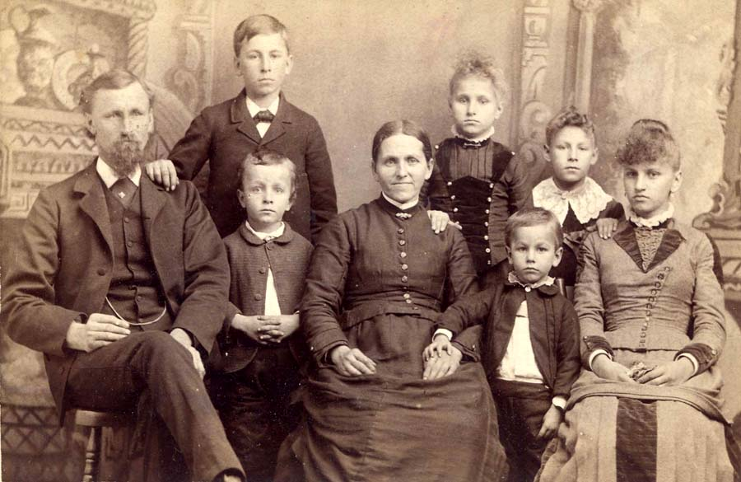
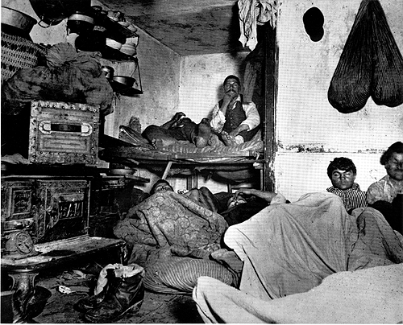
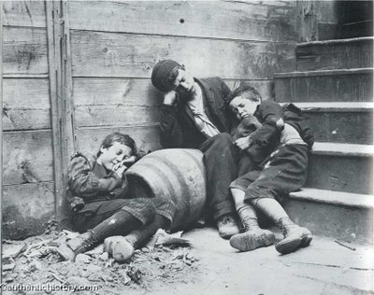
Urban Society
The Middle Class
The Upper Class
The Urban poor
The Working Class

Slide 10
Chapter 13: Urban America
Section 3: The Gilded Age

Slide 11
The Gilded Age
Was:
Was a period in U.S. history from 1870 to 1900 where America seemed to sparkle from the outside, but critics pointed out corruption, poverty, crime, and great disparities between the rich and the poor.

Slide 12
Crime, Poverty & Pollution
Crime
Murder Rate:
1880 = 25 per million people
1900 = 100 per million people
Thomas Burns – Photograph criminals “Mug Shots”
Poverty
Jacob Riis – wrote “How the Other Half Lives”
Pollution
George Warring – head of Sanitation System
1st American to work on the environment

Slide 13
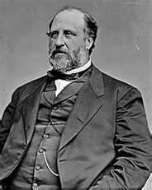
Corruption
Political Machines:
An organization linked to a political party that controls local government through manipulation
Citizens needed: jobs/housing/food/heat/protection
In exchange for votes
Example
William “Boss” Tweed
Ran Tammany Hall (New York City)
Graft
Getting money through dishonest means
Bribery

Slide 14
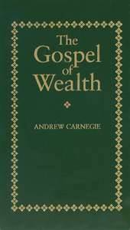
“The Gospel of Wealth”
Created by:
Andrew Carnegie
Said:
“Wealthy Americans should engage in philanthropy and use their great fortune to create conditions the would help people help themselves”
Examples:
Build Schools & Hospitals

Slide 15
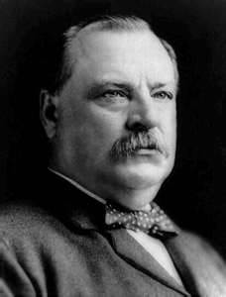
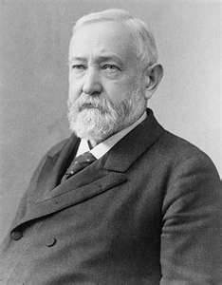
Election of 1888
Who ran:
Grover Cleveland (Democratic)
Wanted to lower Tariffs
Benjamin Harrison (Republican)
Keep tariffs high
Result:
Cleveland won popular vote
Harrison won electoral vote

Slide 16
Is Social Darwinism the best approach for ensuring progress & economic growth ???????

Slide 17
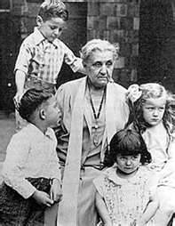
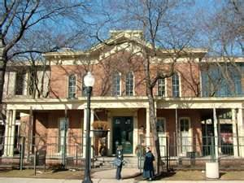
“Social Gospel” Movement
Goal:
Help the Urban poor
Based on:
Biblical ideals and charities
Examples:
Salvation Army
Young Men’s Christian Association (YMCA)
Settlement Houses – community centers for the poor
Hull House – Chicago
Founded by Jane Adams

Slide 18
Chapter 13: Urban America
Section 4: Populism

Slide 19
Rural America
Farmers began to have problems:
New farming technology
Allowed more land to be farmed = more crops = surplus =
Couldn’t make money
Couldn’t: buy supplies / pay mortgage = Debt
Hard to pay off debt
Wealthy controlled banks / supply of money
Cause Deflation – increase in the value of money
Monopoly over the railroads
Farmers were overcharged to ship crops
Interstate Commerce Act – designed to regulate shipping rates on railroads
Not Enforced ………………….

Slide 20
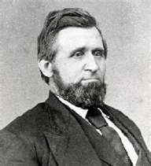
Farmers Unite
The Grange
1st national farm organization (political Organization)
Founder = Oliver Hudson Kelley
By 1874 had almost 1.5 million members
The Farmer’s Alliance
Goal:
Create massive Cooperatives
Organization that tries to increase prices and lower costs for members

Slide 21
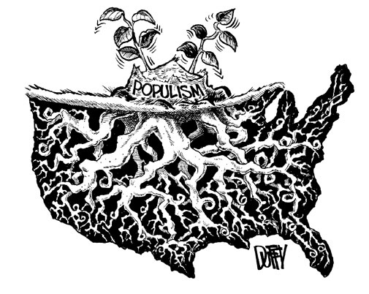
Populism
Was a movement to increase farmers' political power and to work for legislation in their interests
Also called = “The Peoples Party”
Proposed:
Graduated income Tax
Tax higher earners “wealthy” more heavily than lower earners “poor”

Slide 22
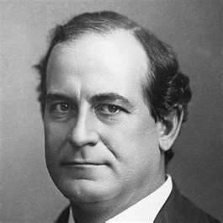
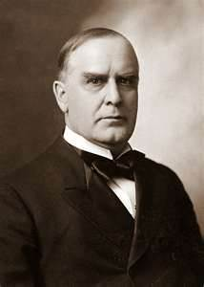
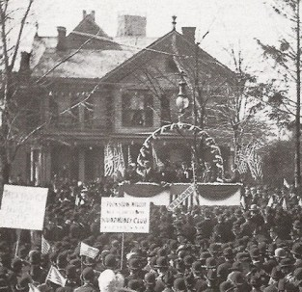
Election of 1896
Who Ran:
William Jennings Bryan (Democrat)
Supported by the Populists
Wanted: bimetallism
Limited Working hours
government regulation of Railroads
William McKinley (Republican)
Supported by the “The Monopoly Men”
“Front Porch Campaign”

Slide 23
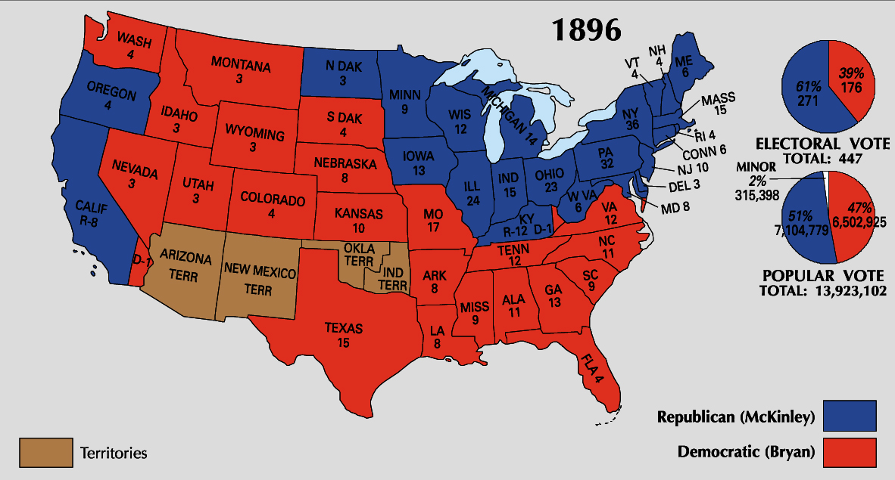

Slide 24
Chapter 13: Urban America
Section 5: Segregation

Slide 25
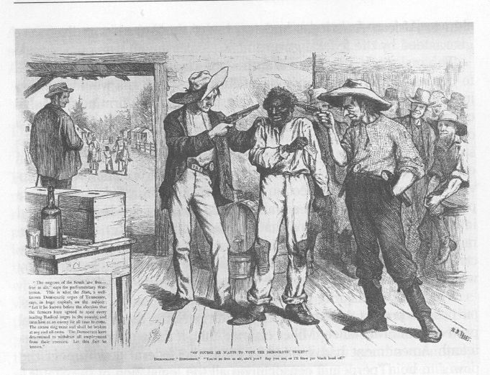
Segregation
Is the separation or isolation based on race
Became known as “Jim Crow Laws”
Goal:
To deny African Americans rights (the right to vote)
Example
Poll tax:
All votes must pay $2.00 to vote

Slide 26
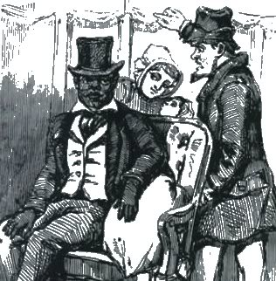
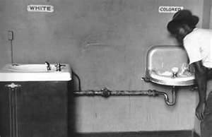
Plessy vs. Ferguson (1896)
Homer Plessy was an African American man who sat on a white section of a train and was arrested.
Court ruled in the idea “separate but equal” for whites and African Americans.
Legalizing Segregation

Slide 27
African American Response
African American | Response
Ida B. Wells
Booker T. Washington
W.E.B. Du Bois

