Slide 1
Chapter 12: Industrialization
Big Business & Labor Unions

Slide 2
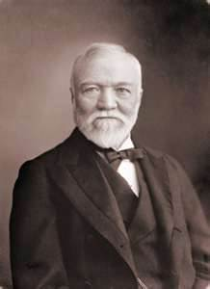
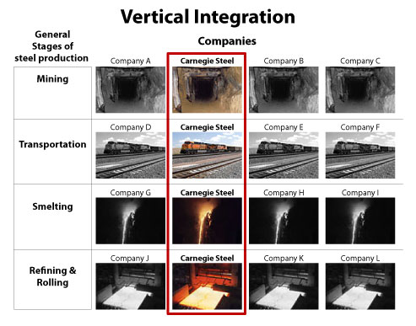
Andrew Carnegie
Scottish Immigrant
Built: Carnegie Steel
Invented: Vertical Integration
  A company that owns all parts of the Industrial Process

Slide 3
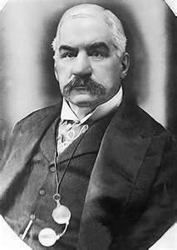
J.P. Morgan
Bought Carnegie Steel
  Became U.S. Steel
Holding Companies
  Is a business that owns stock in its own company …
Controlled over 5,300 factories
Net worth = over $7 billion (1904)

Slide 4
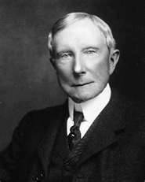
John D. Rockefeller
Built: Standard Oil
Invented: Horizontal Integration
  combines business in the same field
  into one big company
Monopoly:
is when a single Company owns the entire market

Slide 5
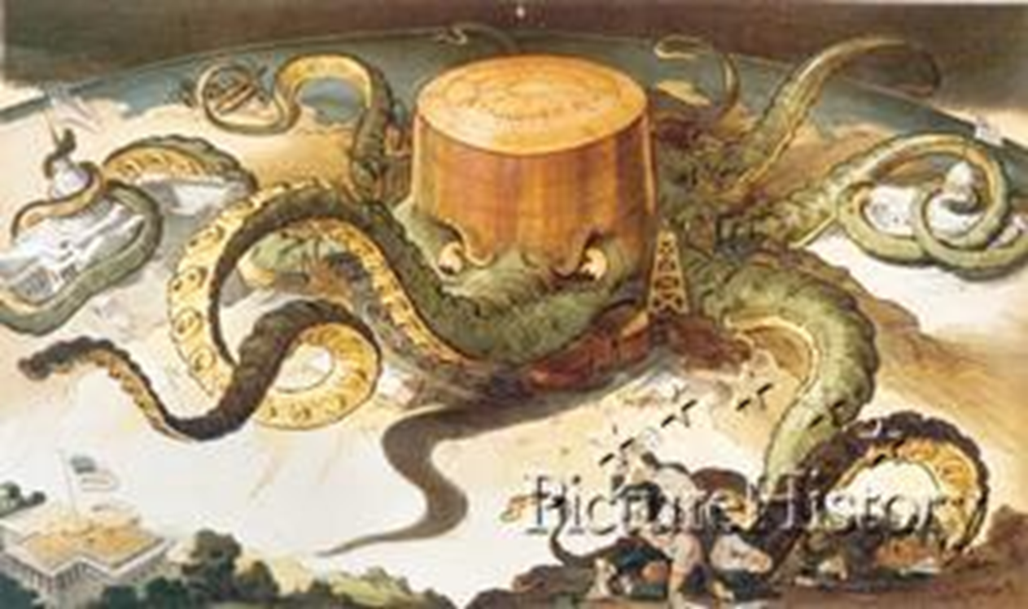

Slide 6
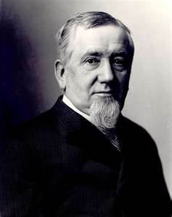
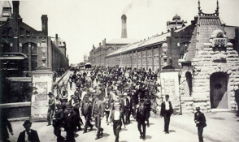
George Pullman
Built: Pullman Railroad Company
Railroad Towns
Lead to the Pullman Strike

Slide 7
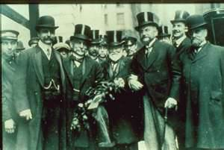
“Robber Barons”
Extremely wealthy men of the late 19th century that controlled all aspects of life and amassed their wealth by using questionable practices……
Lead to the Sherman Antitrust Act
  federal law banning any trusts / monopolies
    hard to enforce / interpret

Slide 8
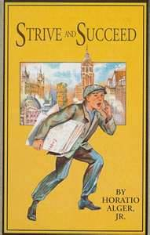
Business Philosophy
Social Darwinism
  Humans have developed through competition and natural selection
    “Only the strong survive”
    “Survival of the Fittest”

Slide 9
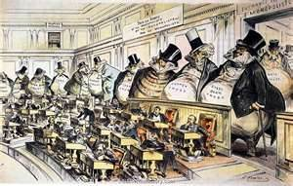

Slide 10
Labor Unions
Are:
  Organizations of workers who ban together for better working conditions
  National Labor Union (William Sylvis)
    For all Workers
    Called for 8 hour work days
  Knights of Labor (Uriah Stephens)
    For all Workers
    8 hour days
    Equal Pay
    Opposed strikes

Slide 11
Labor Unions
American Federation of Labor (Samuel Gompers)
  Skilled/White/males
  Called for collective bargaining
  Liked Strikes
American Railroad Union (Eugene Debs)
  Only Railroad workers
  Pullman Strike
Industrial Workers of the World (Bill Haywood)
  Unskilled workers “Wobblies”
  All races
  Men & Women

