Slide 1
Chapter 11 Westward
Western Expansion
Settling the West
1850s-1900

Slide 2
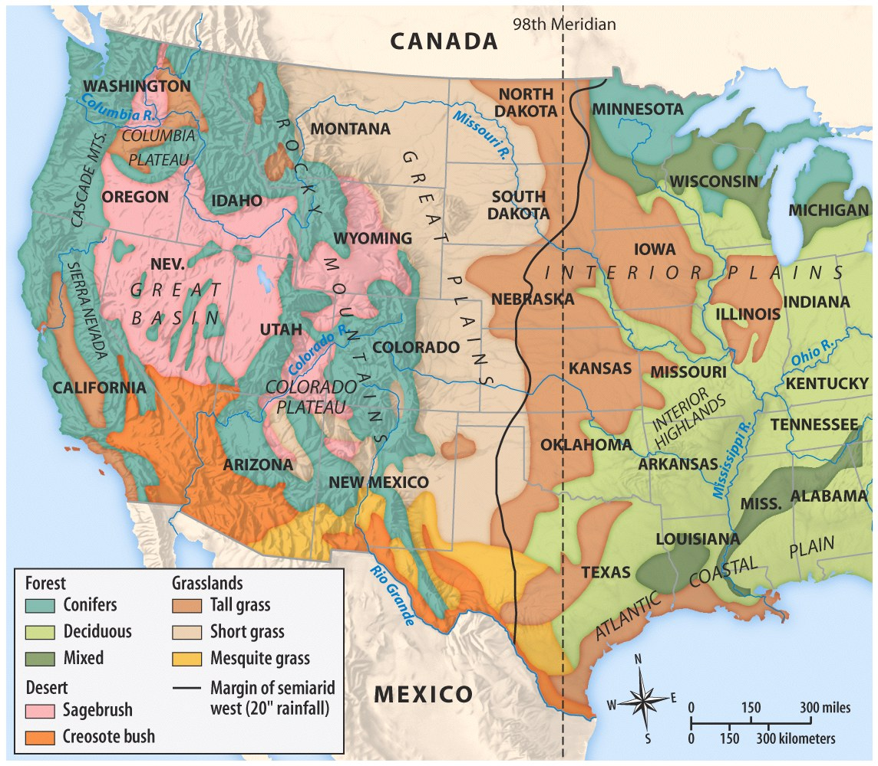
“THE WEST”

Slide 3
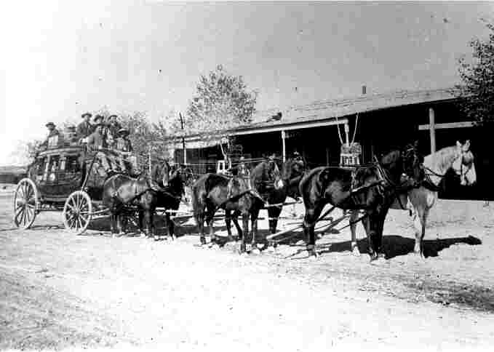

Slide 4
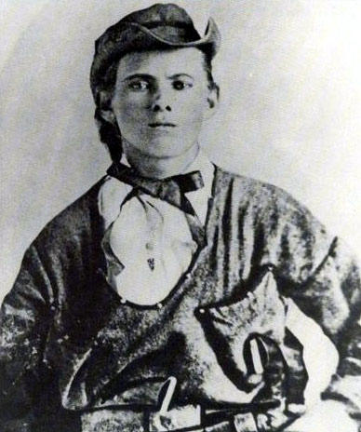
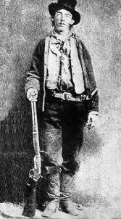

Slide 5
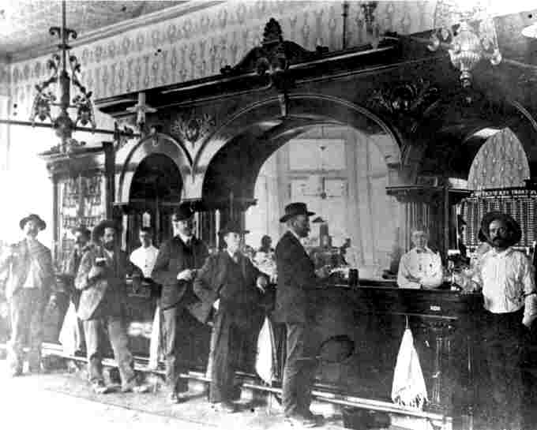

Slide 6
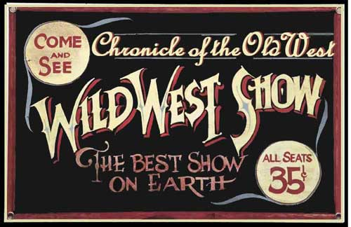

Slide 7
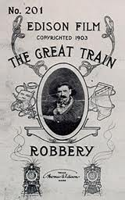

Slide 8
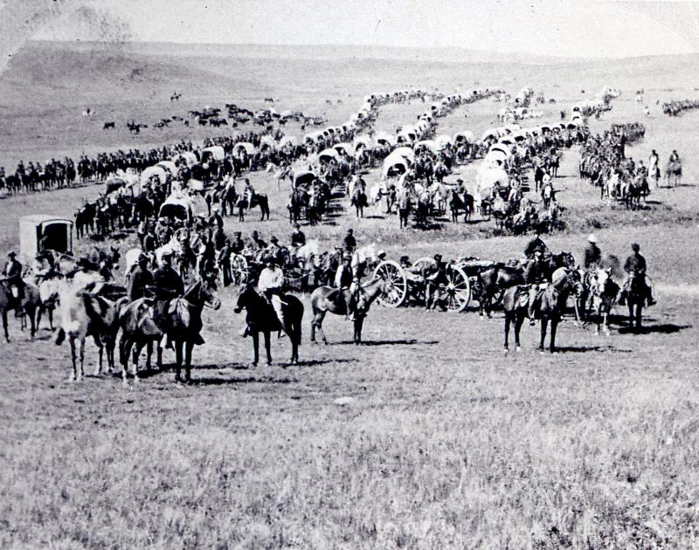

Slide 9
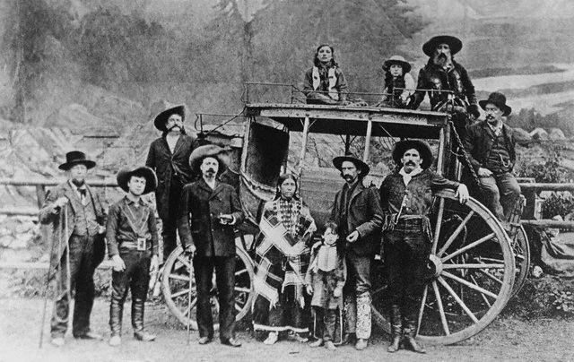

Slide 10
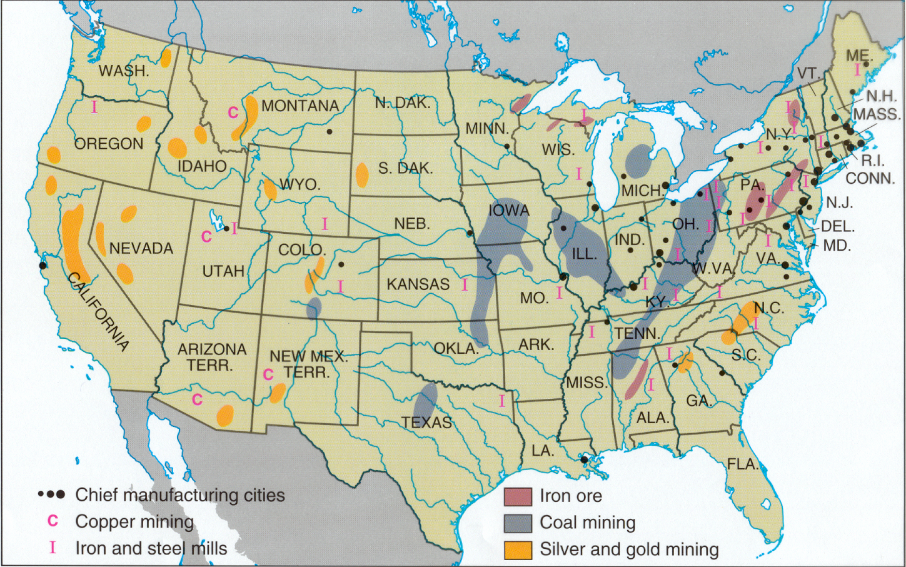
Mining Centers
Virginia City Comstock Lode
“BIG BONAZA”
City of Comstock Lode:
Frontier City to BOOM TOWN. Had an Opera house and first 6 story hotel that had and ELAVATOR!

Slide 11
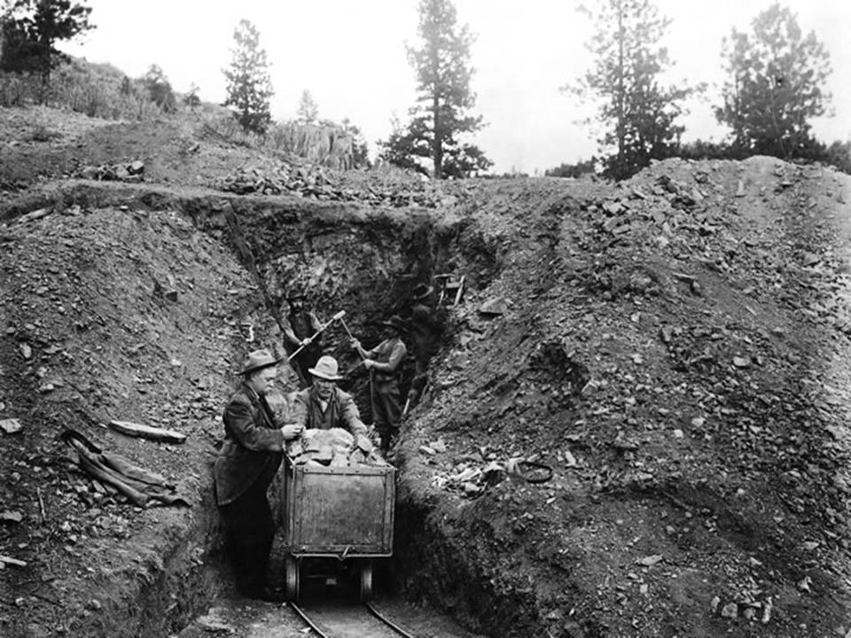

Slide 12
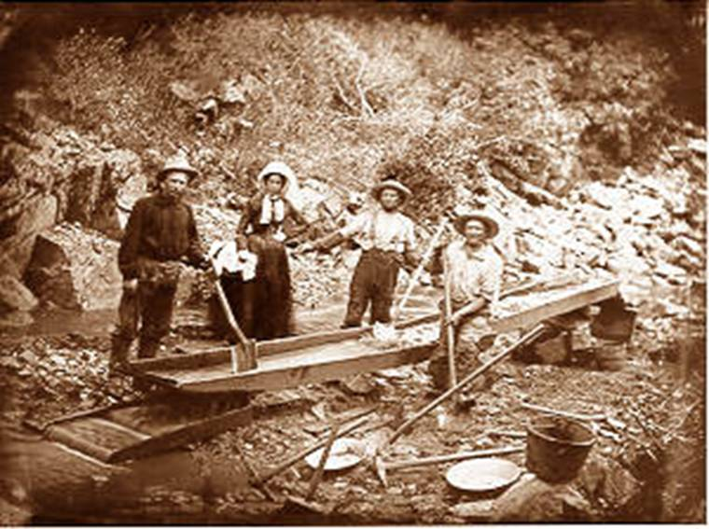
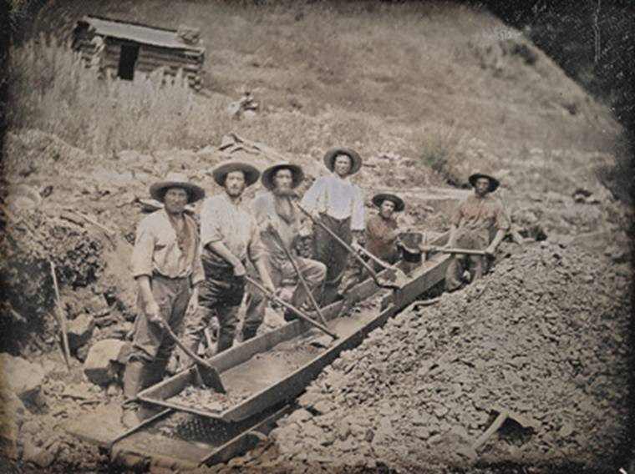

Slide 13
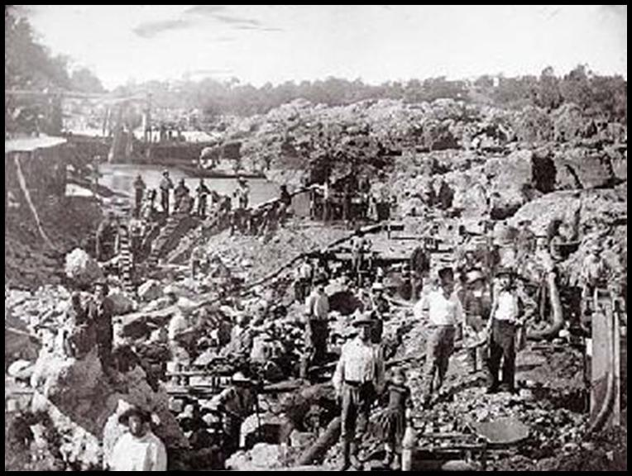

Slide 14
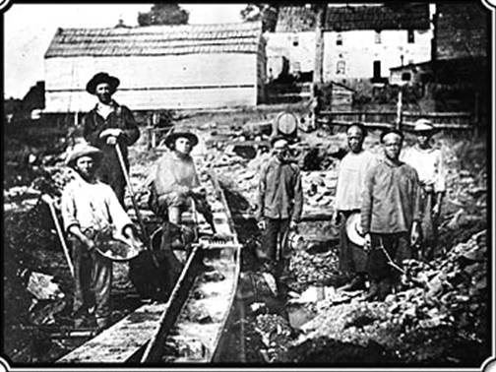
Prospecting
The Gold Rush Swarmed in… all looking to get RICH overnight!

Slide 15
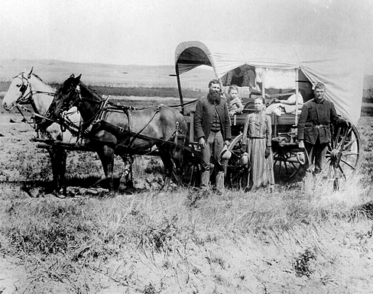
LIFE ON THE GREAT PLAINS
Dry farming Allows cultivation of arid (dry) land by using drought-resistant crops and various techniques to minimize evaporation.

Slide 16
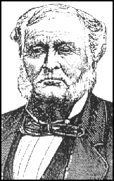
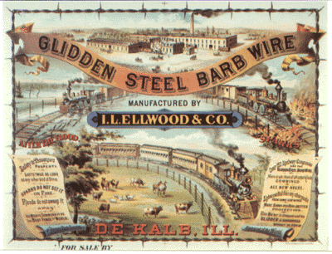
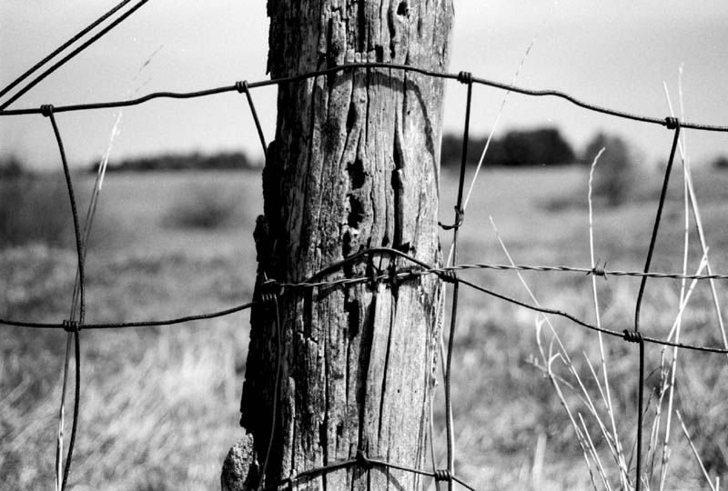
Invention of Barbed Wire
Joseph Glidden

Slide 17
LIFE ON THE GREAT PLAINS
1. Barbed wire fence was a lifesaver because of the lack of wood in the dry plains of America.
2. Barbed wire also solved the problems between farmers and ranchers.

Slide 18
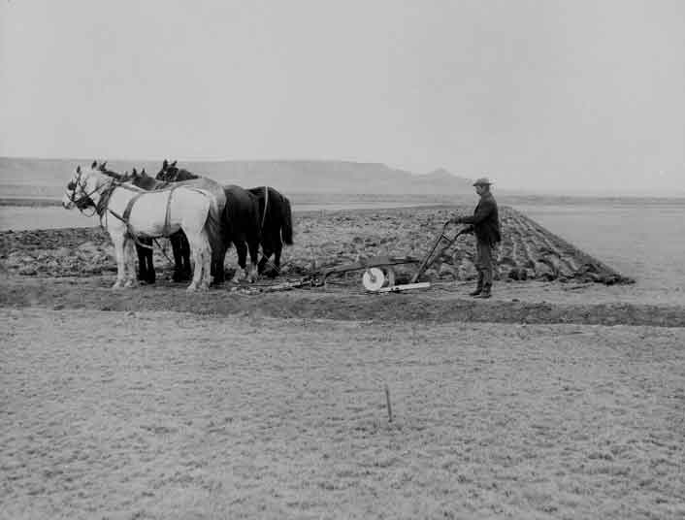
Steel Plow
Allowed farmers to cut through dense, root-choked sod.

Slide 19
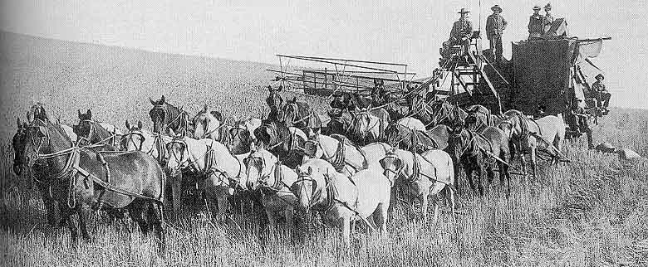
Mechanized Reaper
Reduced labor force needed for harvest. Allows farmers to maintain larger farms.

Slide 20
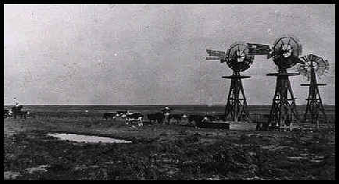
Steel Windmill
Powers irrigation systems and pumps up ground water.

Slide 21
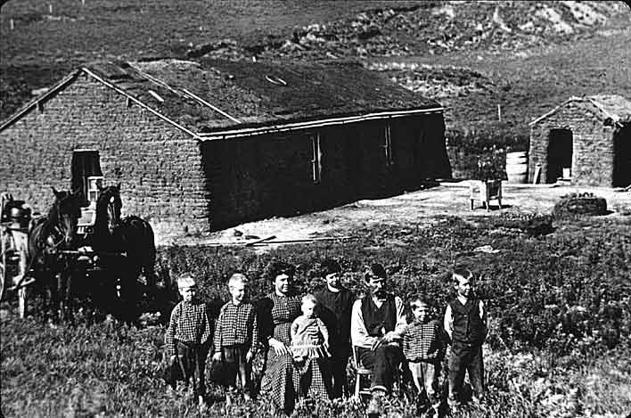
HOMESTEAD ACT
Homestead Act was a law developed in 1862 by Congress to promote settlement of the Great Plains.
Age 21 and the head of the family could have 160 acres of land if they improved it in five years
Could buy it for a small amount of $$$
The US Government encouraged westward expansion and the Homestead Act allowed thousands of settlers to move west and start new lives.

Slide 22
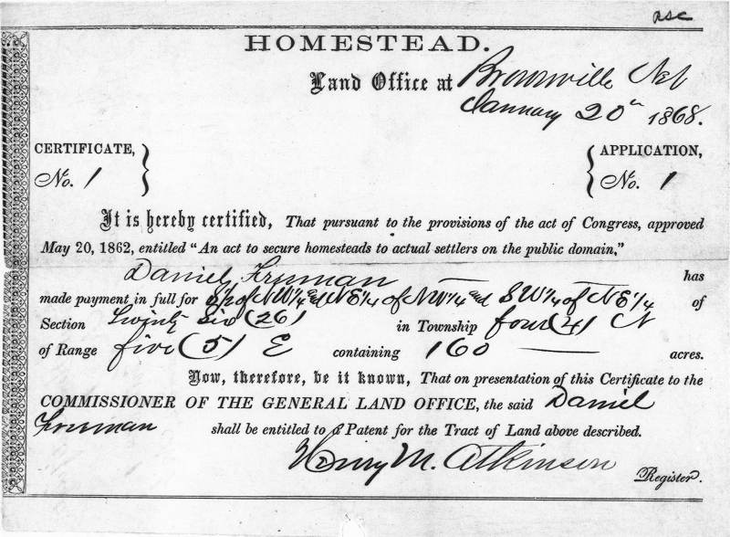

Slide 24
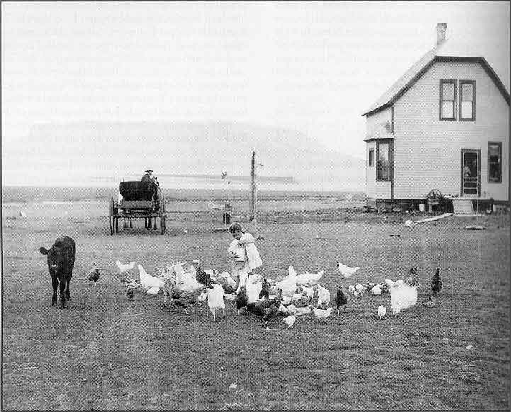

Slide 25
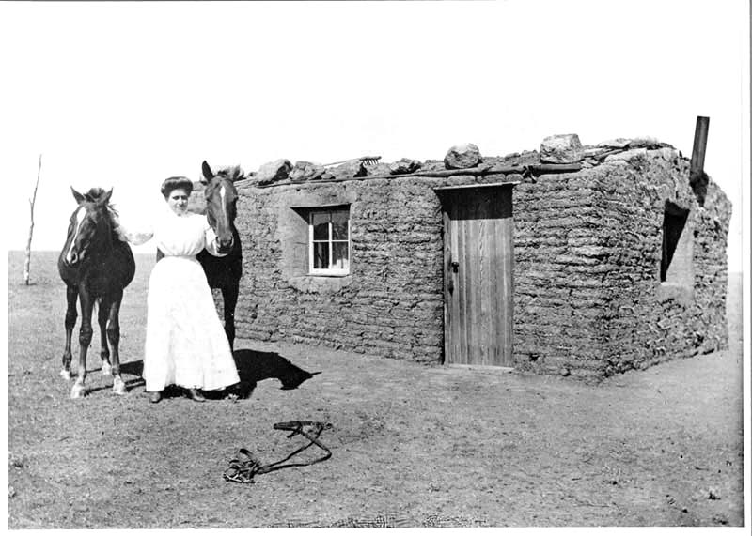
A Pioneer’s Sod House, SD

Slide 27
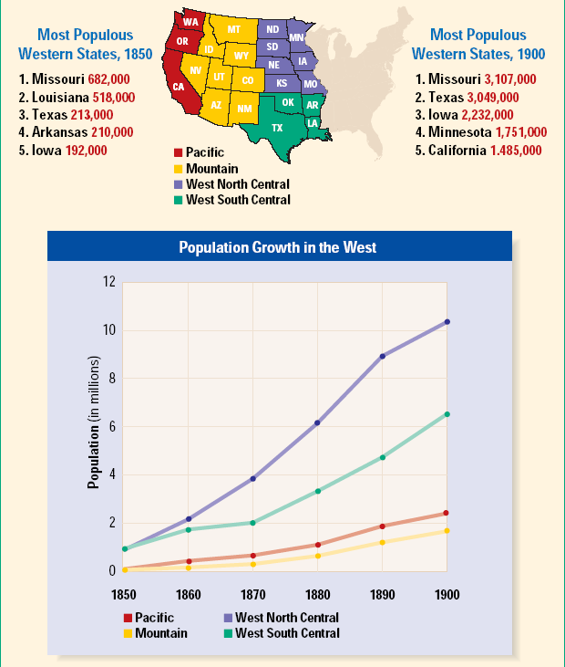
Population Changes in the West, 1850 to 1900

Slide 28
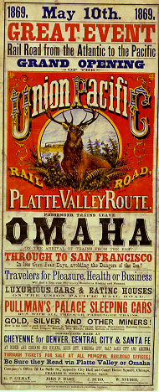
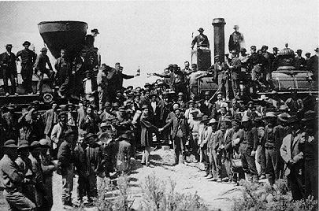
1st TRANSCONTINENTAL RAILROAD
May 10, 1869 at Promontory, Utah
“The Wedding of the Rails”
Central Pacific and Union Pacific

Slide 29
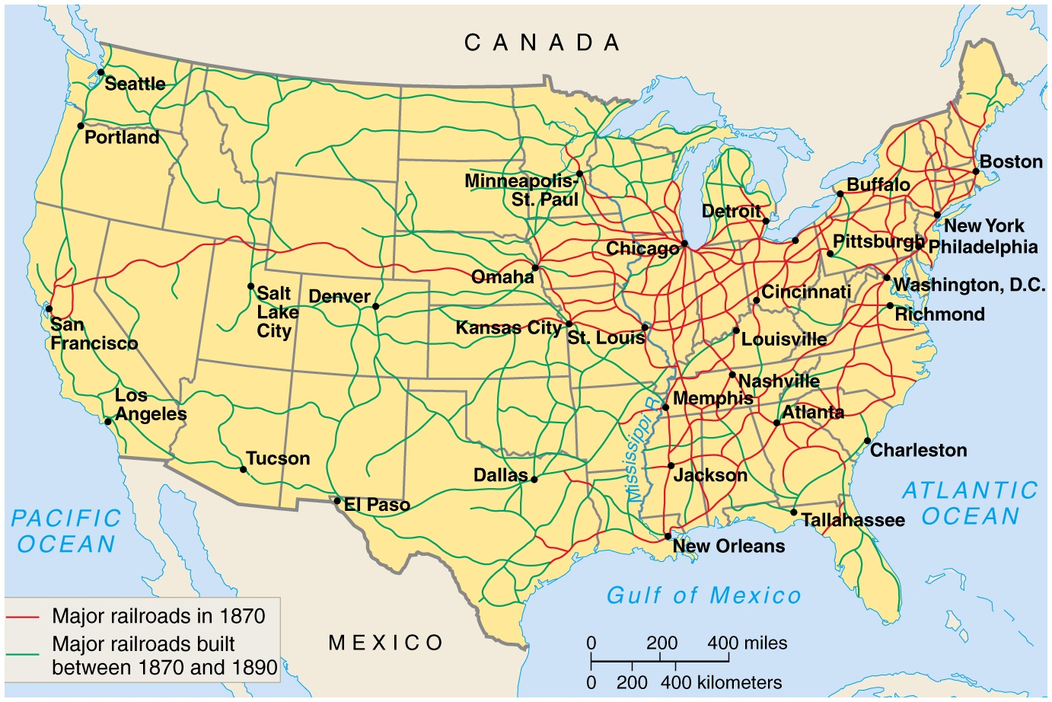
Promontory, Utah

Slide 30
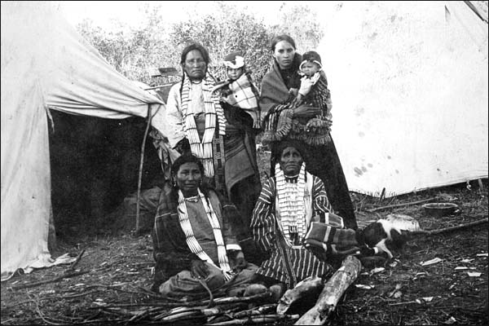
U.S. Indian Policy

Slide 31
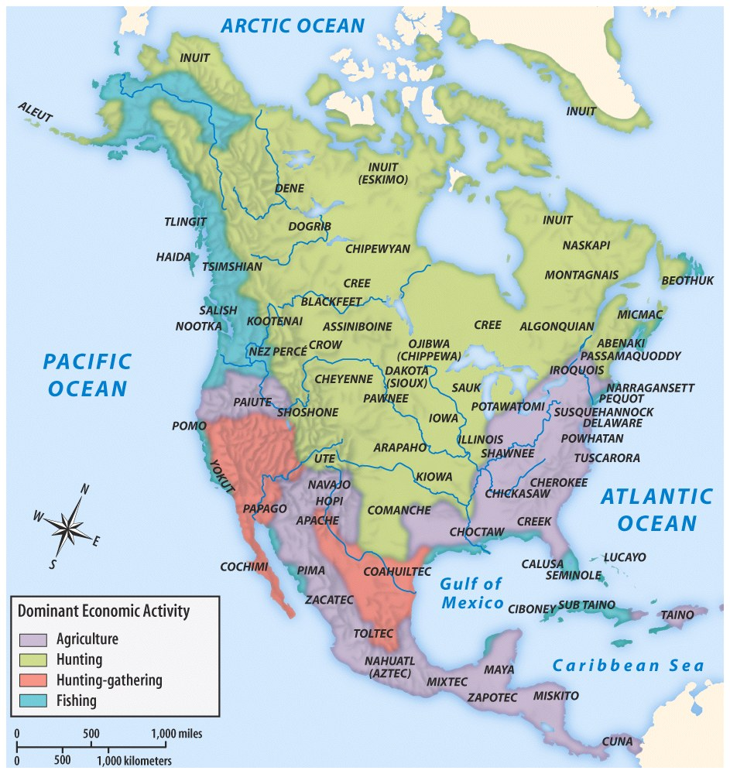
Tribes of the Great Plains
Sioux
Cheyenne
Crow
Arapaho
Kiowa

Slide 32
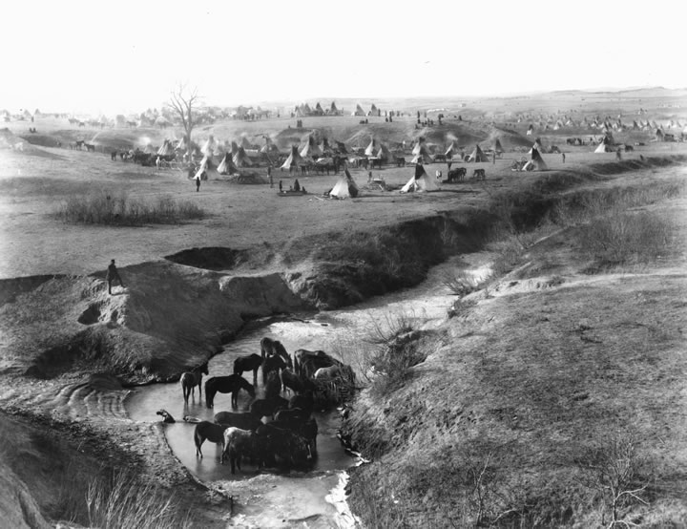

Slide 33
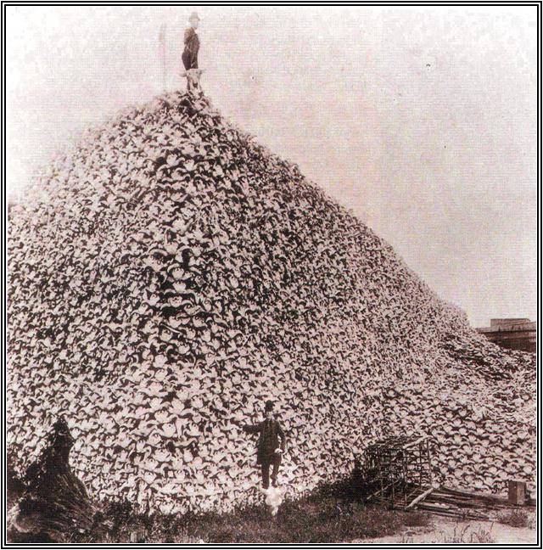
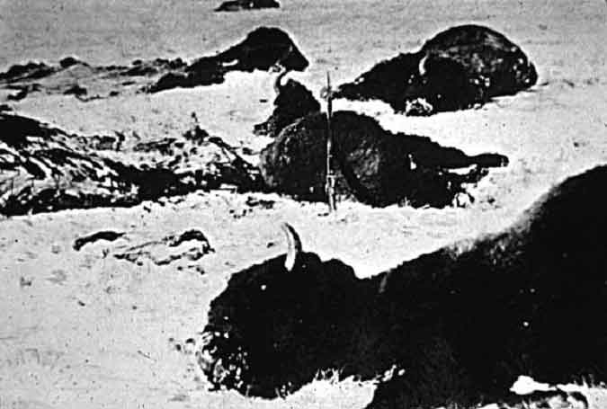
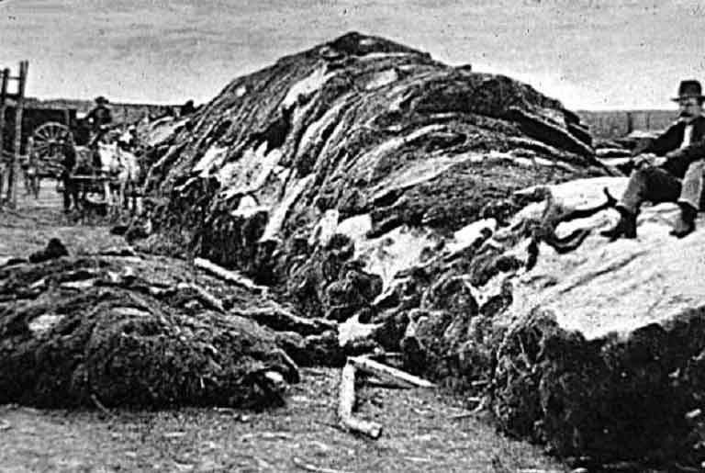
Skull
US INDIAN POLICY
Massacre of Buffalo
Take away the food source from the Native American and they will be forced to submit and go to the reservations.

Slide 34
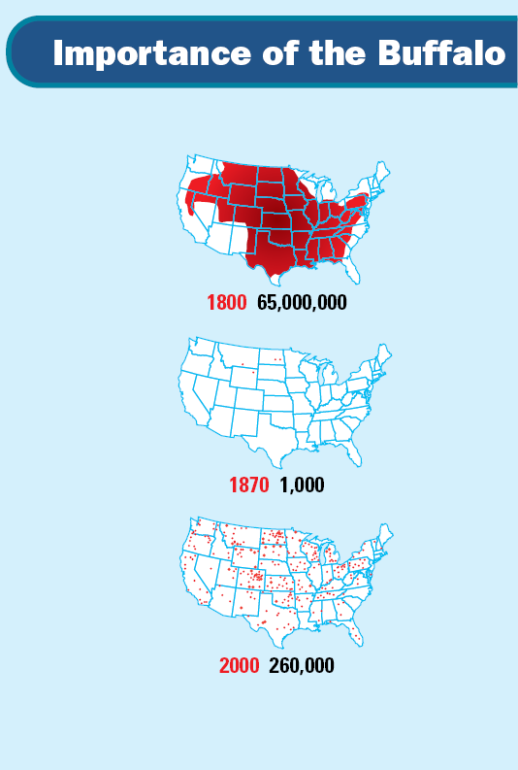
1871 to 1875, the US supported the extermination of 11 million buffalo.

Slide 36
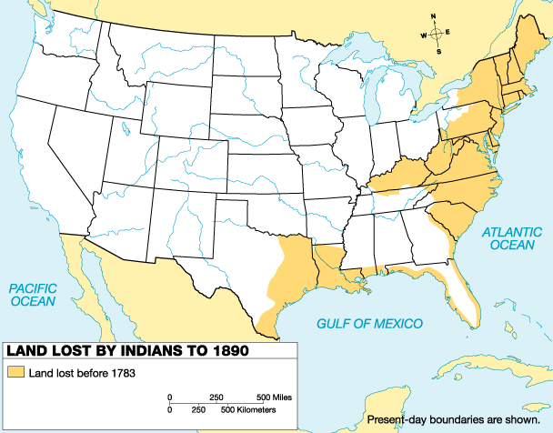
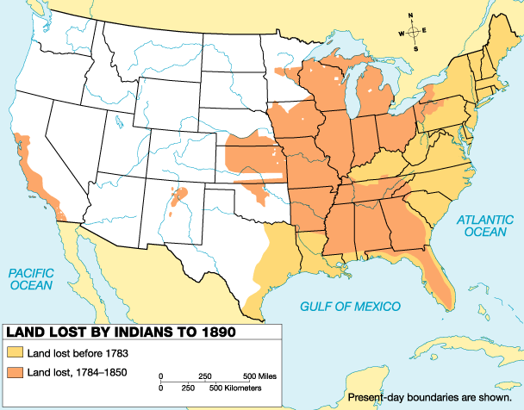
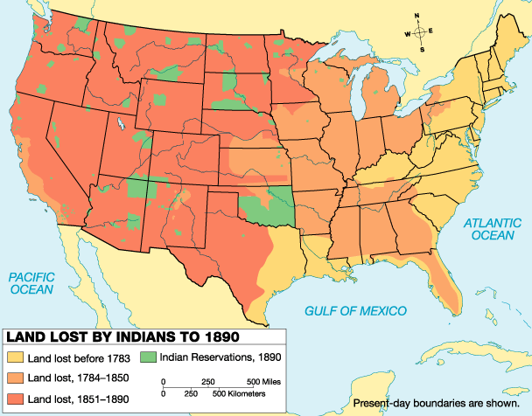
Map 13 of 45

Slide 37
clash
INDIAN CONFLICTS
Differences in land ownership
Railroad
Settlers trespassing on Indian Land
Discovery of gold
Slaughter of the buffalo
Broken treaties

Slide 38
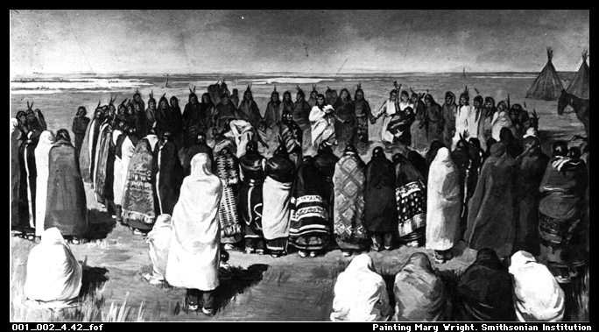
U.S. INDIAN POLICY
Dawes Act of 1887
Quicker Americanization
Assimilate, mainstreamed and absorbed into US society
Adopt Christianity and White education
Individual land ownership
Abandon tribe, culture and become farmers
Male claimed 160 acres of land
Children would be sent to Indian schools
Farm land for 25 years.
1924 gain citizenship and right to vote
Failed policy
Indian resistance and corruption

Slide 39
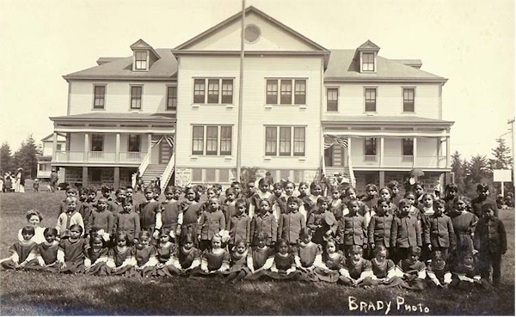
Indian Assimilation Attempts
Native American children were taken to off-reservation Indian schools where they would be taught white man’s ways.
ASSIMILATE- To absorb one into a culture

Slide 40
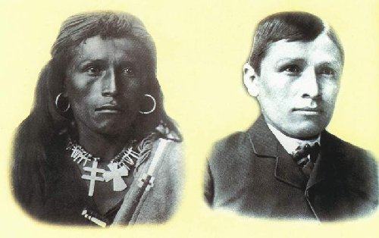

Slide 41
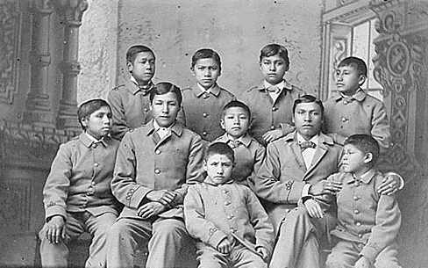
Dawes Act (1887)
Carlisle Indian School, PA

Slide 42
Sitting Bull and Crazy Horse
Sitting Bull (Sioux) and Crazy Horse (Cheyenne) were two chiefs who refused to sign the treaty.
They defiantly left the reservation.
"One does not sell the earth upon which the people walk" -Crazy Horse

Slide 43
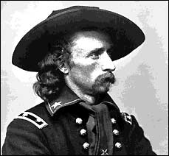
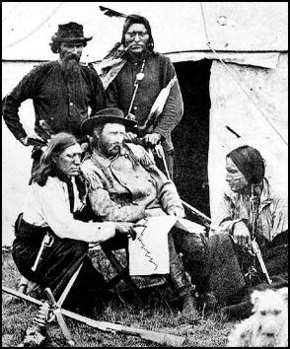
Little Big Horn River, Montana - 1876
George Armstrong Custer was sent to force the Sioux, Cheyenne and Arapaho back to their reservations.
He was in command of the 7th Calvary.
June 26, 1876

Slide 44
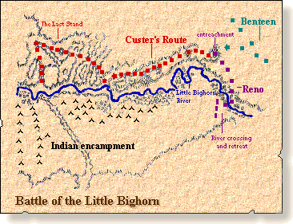
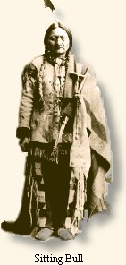
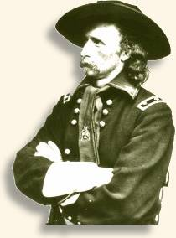
The Battle of Little Big Horn 1876
He was heavily outnumbered and trapped.
Custer & all 220 of his men died.
“Custer’s Last Stand” outraged Americans and led to govt. retribution.
The Sioux and Cheyenne were crushed within a year.

Slide 45
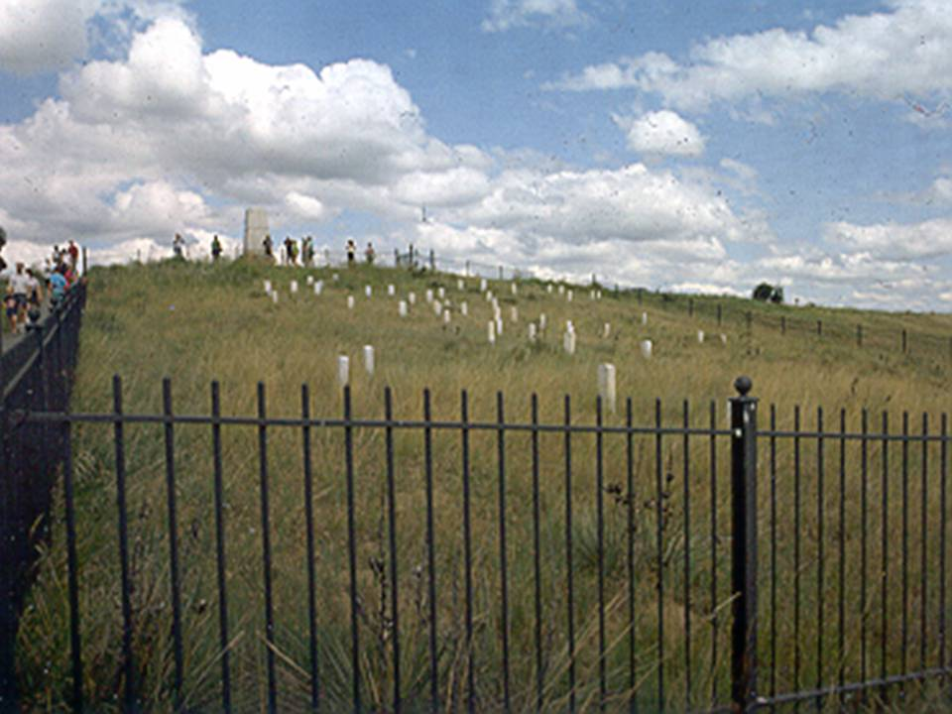
Little Bighorn

Slide 46
Little Bighorn

Slide 47
Painting-Little Bighorn
LITTLE BIGHORN

Slide 48
Native American pow wow
Modern Day Native Music—A Tribe Called Red
https://www.youtube.com/watch?v=_zH9wHWMi_k

Slide 49
A CENTURY OF DISHONOR
Helen Hunt Jackson (1830-1885), activist for Native American rights and author of Century of Dishonor
Heightened public awareness of the federal government’s long record of betraying and cheating Native Americans.
When Jackson sent a copy to every member of Congress with the following admonition printed in red on the cover: "Look upon your hands: they are stained with the blood of your relations."

Slide 50
TURNER THESIS
1890United States Census Bureau announced the official end of the frontier.
In 1893, historian Frederick Jackson Turner claimed that the frontier had played a key role in forming the American character.
The Turner Thesis, stated that frontier life created Americans who were socially mobile, ready for adventure, bent on individual self-improvement, committed to democracy and able to withstand difficult times to accomplish the American Dream…
Frederick Jackson Turner
“RUGGED INDIVIDUALIST”
The frontier created the American character of one who was self-sufficient, persistent and able to withstand difficult times to accomplish the American Dream…

