Slide 1
The Beginning of Civilization

Slide 2
If they are happy swinging in trees, why come down?
Evidences found in the Great Rift Valley, savannas on the Eastern part of Africa
Difficulty in knuckle walking → adapt to bipedalism
Predators abound → flight or fight, shelter and protect
Scattered plants → change in diet, enriched food selection

Slide 3
The Beginning of Civilization
The Earliest Humans appeared about 250,000 years ago
People picked grains and berries and dug roots for food while also hunting until they learned to plant and harvest crops

Slide 4
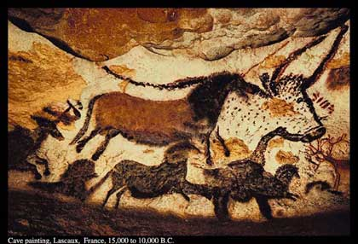
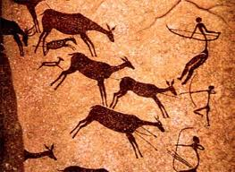
Prehistory
Time before writing was invented
If writing had not been invented yet how do we know what the earliest people did?

Slide 5
How We Know About Early Life
Anthropologists – study the beginnings and development of humans and their cultures
Culture is a way of life for a group of people
Includes beliefs, traditions, government, religion, and social classes
Archaeologists – study of past societies by examining the things people made and left behind

Slide 6
Early Stages of Development
Hominids – walked upright and made stone tools
3 Stages of Development
Australopithecus
Homo Erectus
Homo Sapiens

Slide 7
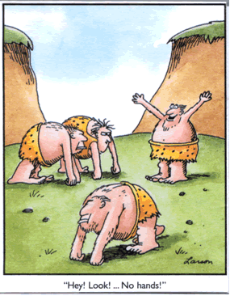
Early Stages of Development
Australopithecus
Lived in eastern and southern Africa
3 to 4 million years ago
Walked upright and made a few simple tools from stone

Slide 8
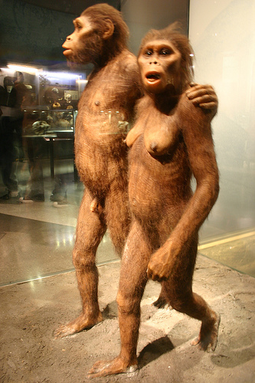
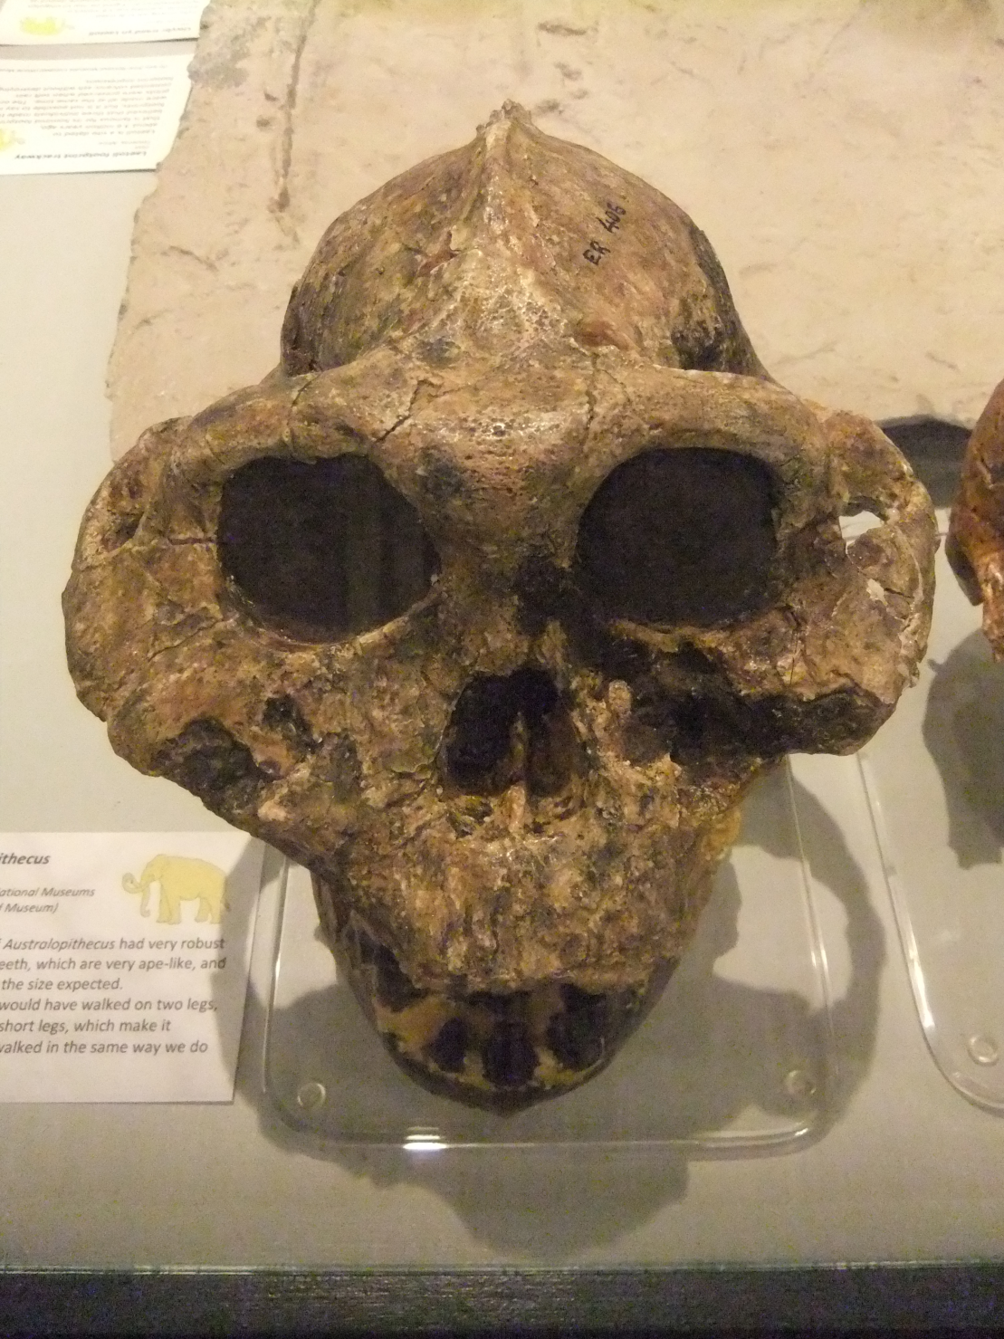

Slide 9
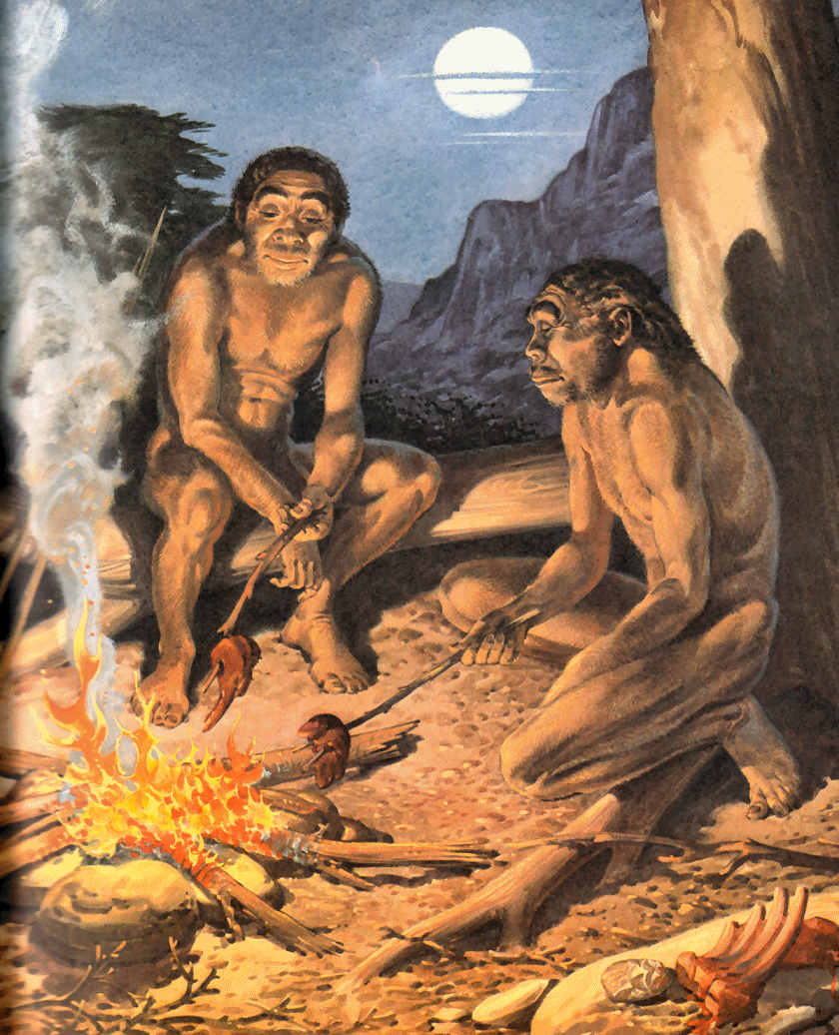
Early Stages of Development
Homo Erectus
Walked Upright
Made advanced stone tools
Began in Africa
Fire was discovered and they learned how to keep it burning safely
1.6 million years to 200,000 years ago

Slide 10
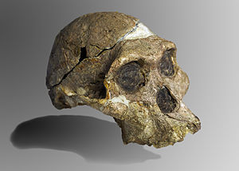
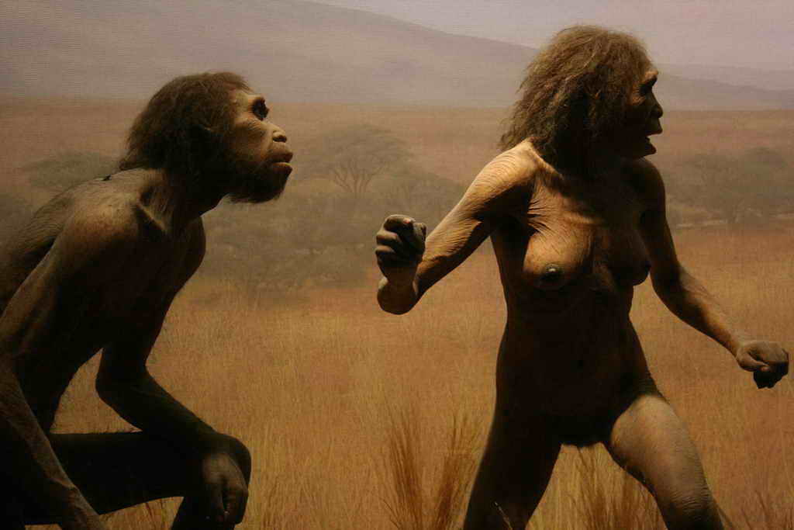

Slide 11
Early Stages of Development
Homo Sapiens Sapiens
Africa
Homo Sapiens Sapiens
Australia
Homo Sapiens Sapiens
Asia
North and South America
Homo Sapiens Sapiens

Slide 12
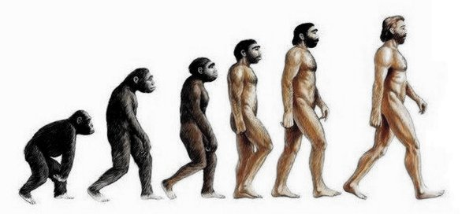
Step through the Evolutionary Trail

Slide 13
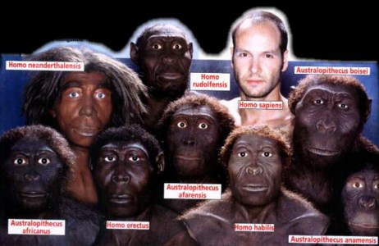

Slide 14
Moving from one continent to another

Slide 15
Hunters and Gatherers
Nomads – people who move from one location to another and lived by hunting and gathering food
Women dug plants and roots and gathered berries, nuts, fruits and grains to add to meat
Nomads did not know how to farm and were known as hunters and gatherers

Slide 16
Hunters and Gatherers
Prehistoric people spent most of their time finding and preparing food
Inventions of the hunters and gatherers
Speech – communicate plans for the hunt
Tools – stone and fishhooks from bone
Clothing – needles to sew skins together
EQ—Why would it have been imperative for Hunter/Gather’s to be nomadic (moving constantly)?

Slide 17
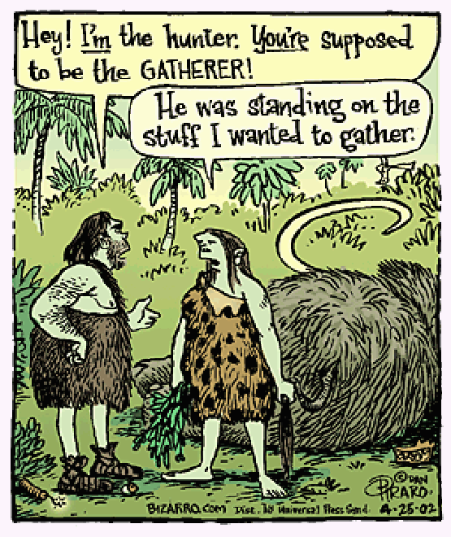

Slide 18
Farming and the Beginning of Civilization

Slide 19
Neolithic Revolution
Development of farming created a great change among the hunters and gatherers

Slide 20
First Farmers
Farming began in 8,000 BC in Southwest Asia
Experts can only speculate how farming became domesticated
Placed seeds on the ground and placed dirt over them or dug holes and placed seeds in the holes

Slide 21
First Farmers
Southwest Asia
Wheat
Barley
China
Rice
Mexico and Central America
Beans
Squash
Maize

Slide 22
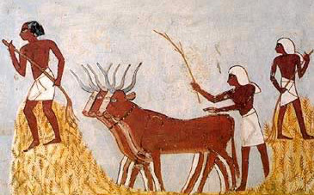
First Farmers
Domestication of Animals
Hunters captured animals and placed them into pens until they were killed for their meat
Animals also provided milk, clothing, blankets, labor aids

Slide 23
New Ways of Life
Once people controlled the source of their food they could begin to settle down and build sturdy homes
Towns and villages became bigger and offered various opportunities for people
Craft workers – potters, basket weavers, bronze weapons and jewelry
People exchanged food for craft items
EQ—What would domesticating animals be essential in making a transition to being a permanent farmer from being nomadic/hunter/gatherer?

Slide 24
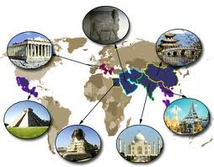
What is a Civilization?
Complex culture that includes beliefs, traditions, government, religion, and social classes

Slide 25
The Six Characteristics | Of Civilization
Cities | Center of early civilizations
Central Government | Government keeps order and helps people work together
Religion | Developed religions to explain nature. Believed gods or deities would help people
Social and Economic Classes | Social hierarchy was set up based on wealth
Arts and Architecture | Palaces and temples were built and decorated with statues and paintings
Writing | Keep tax records for the government

